Slide 1

GO2cam V6.09
List of New Features
139 rue Vendôme, 69007 Lyon, France

Slide 2
GO2cam V6.09 New Features
Licensing
New typology of Licences
Licences WAN
VAR
Production (end-users)
Educ
Please read the dedicated document
Dev and VAR: Modules and Options are automatically selected
Production and Educ need Bits
→ Educ file cannot be read by a production licence
→ Dev and VAR can read everything
The type of licence is displayed in the Homepage

Slide 3
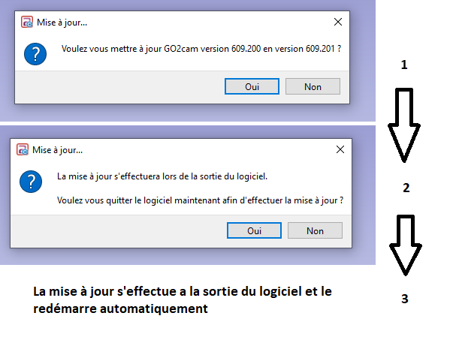
GO2cam V6.09 New Features
Installation
New concept for the Update of software
The update of software is not done anymore with patches.
The update is done only with the command ‘Update Software’.
The user can choose whether he can update or not the version.
2 stages:
1. Do you want to update? Yes or No
2. If Yes, you can choose whether to exit the software now & run the update or to exit and update later manually.
Advantages:
The installation is fully automatic.
No more possible mistakes, due to manual modification of DAT files for example.

Slide 4
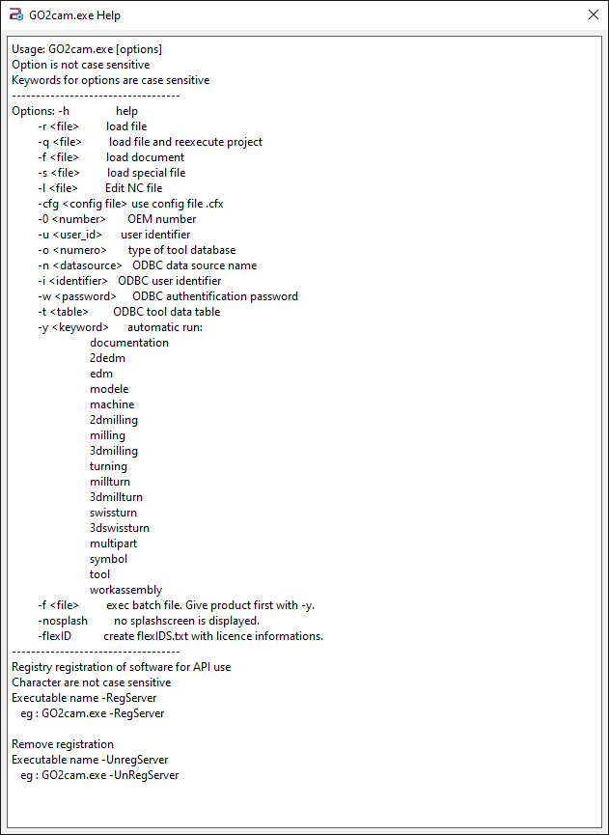
GO2cam V6.09 New Features
Launch
*.exe Launching
When launching GO2cam with the option -h, we display now a dialog box with all the available options.

Slide 5
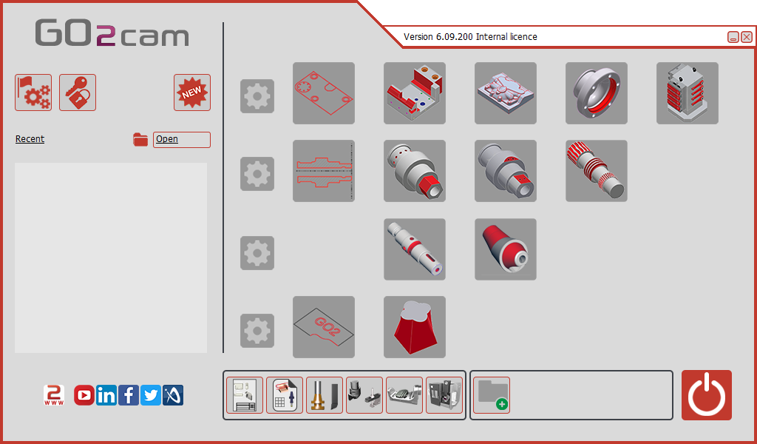
GO2cam V6.09 New Features
Homepage
Access for the 2 new modules of swiss machining
The type of licence is displayed in the banner.

Slide 6
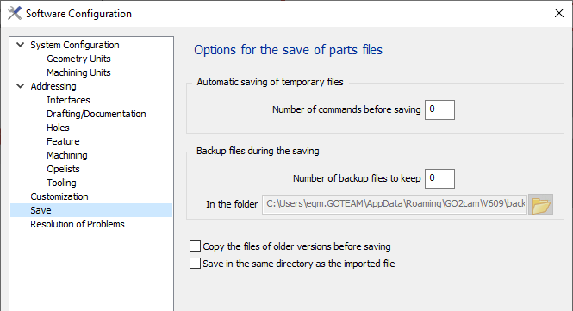
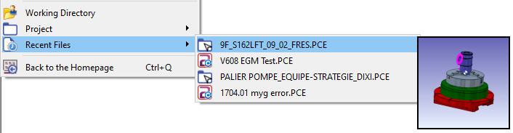
GO2cam V6.09 New Features
Files
14172 Abba
Save imported file
6.08.210
After importing a CAD file, some customers want to save the *.PCE file into the same directory. It can be done by checking the new option: ‘Save in the same directory as the imported file’.
Recent Files
While navigating in the recent files menu, we can now have a view of the workpiece in the*.PCE files

Slide 7
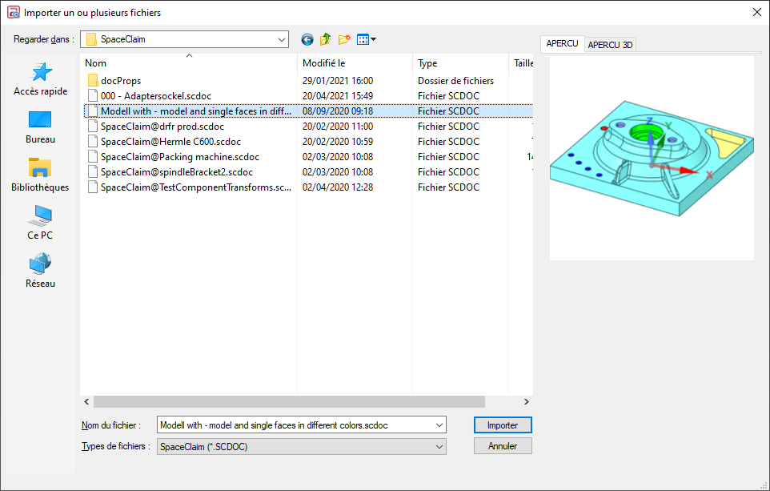
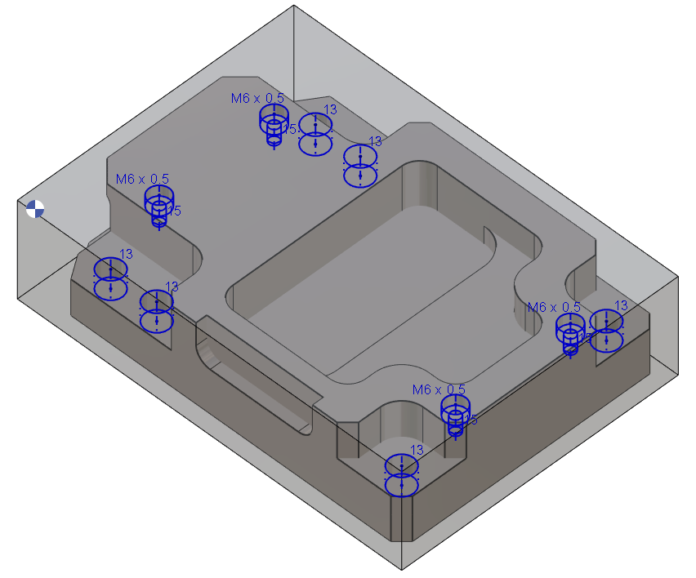
GO2cam V6.09 New Features
CAD Import
Full associativity with Spaceclaim
& management of holes features
Spaceclaim file preview
Holes features recognition and update, Included in the dataGO option.

Slide 8
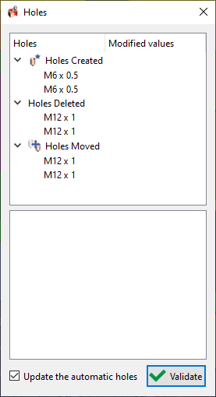
GO2cam V6.09 New Features
CAD Import
FTE import
New dialog box while using the ‘Part Update’ for FTE process.
- If you click in the box, you can see the corresponding holes in the screen,
- The dialog gives the following information:
  moved holes.
  modified holes (topology or size)
  the modified machining operations
- You can run the calculation of automatic holes.
The name of the hole feature is now read and recovered while importing a file with FTE.

Slide 9
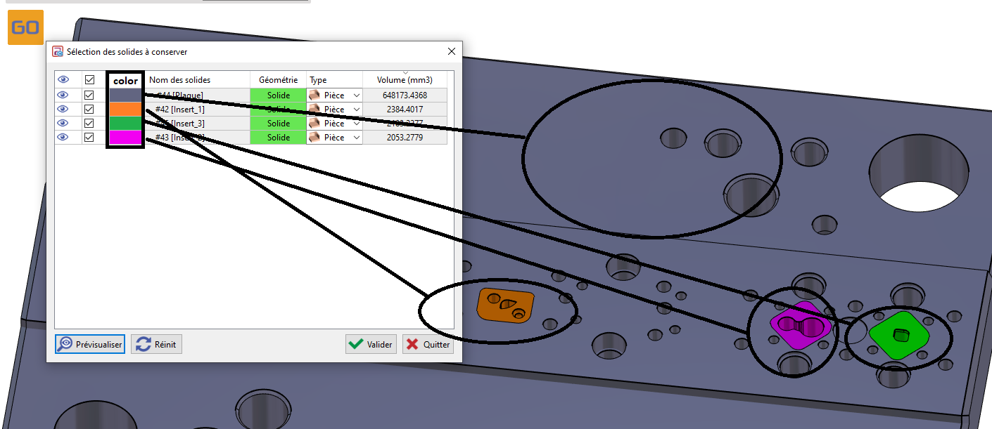
GO2cam V6.09 New Features
CAD Import
Multiple Import
New column ‘Color’ in the dialog box of multiple import, in order to identify easily the solids to be kept.

Slide 10
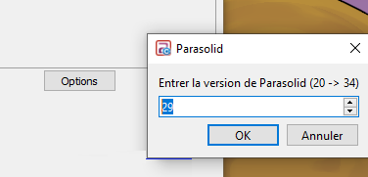
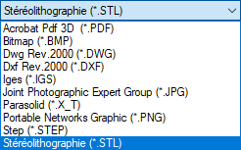
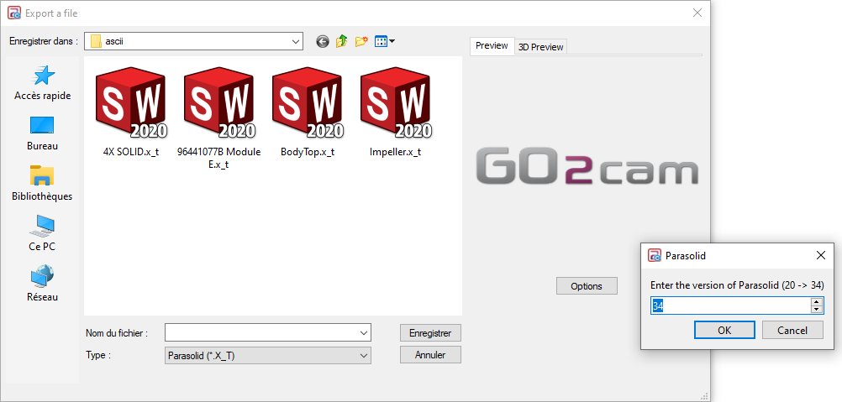
GO2cam V6.09 New Features
CAD Export
Export X_T
14164
CAD Export
New dialog box to choose the version # while exporting in Parasolid (file and stock)
The list of available export file is shorten.
Deletion of export in Catia V5, ACIS, VDA and DXF version 12.

Slide 11
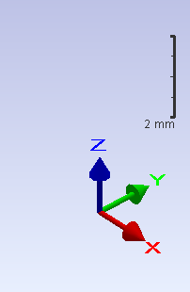

GO2cam V6.09 New Features
User Interface
Interactive Axis System
RGB color becomes the standard in GO2cam.
You can still change the style in
Tools/Options/User Interface
Scale is now displayed in the screen
→ All the icons with systems of axis are also changed

Slide 12
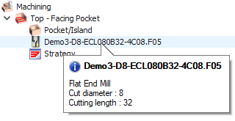
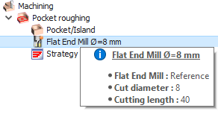

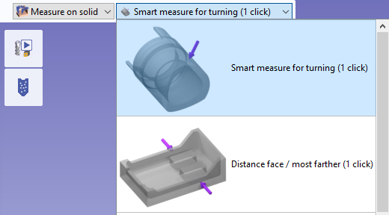
GO2cam V6.09 New Features
User Interface
New Tooltips
New tooltips with HTML formatting ability
Menu Profiles
V6.08
V6.09
Deleted commands:
- Extremity Point
- Bounded → Unbounded
- Recovering the elements of a profile in geometry
Control
The list of options for the measure on solid is now displayed in a combo box (in addition to the popup in background).
The options are also embellished with an explicit icon.

Slide 13
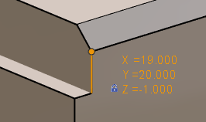
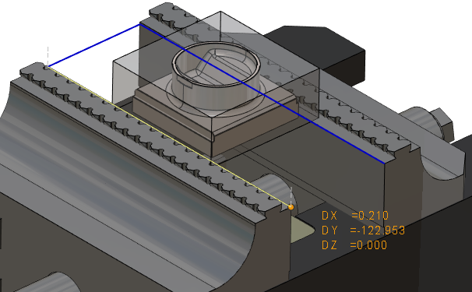
GO2cam V6.09 New Features
User Interface / Geometry
Picking
Picking symbol
New display for the picking of elements (wireframe-solid-symbols)
The extremity is highlighted by a small ball
The coordinates are displayed
An icon shows when the Z altitude is locked to a fixed value. There is no icon if the value is directly read on the geometry.
New ability to draw geometry (wireframe and solid) by picking extremities of symbols.
You can also pick Z value directly on the symbol.
→ It is also possible to define machining depths by clicking the symbol!

Slide 14


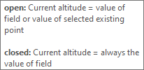
GO2cam V6.09 New Features
User Interface / Geometry
Z Altitude Behaviour
V6.08
V6.09
Checkbox is replaced by the lock icon
Button to pick value is replaced by the pipette
New tooltip

Slide 15

GO2cam V6.09 New Features
User Interface / Wireframe
Dialog Area
No more ENTER command to validate
The spinbox are added for all the fields
Units are given in the field
Display of icons in the combo box.

Slide 16
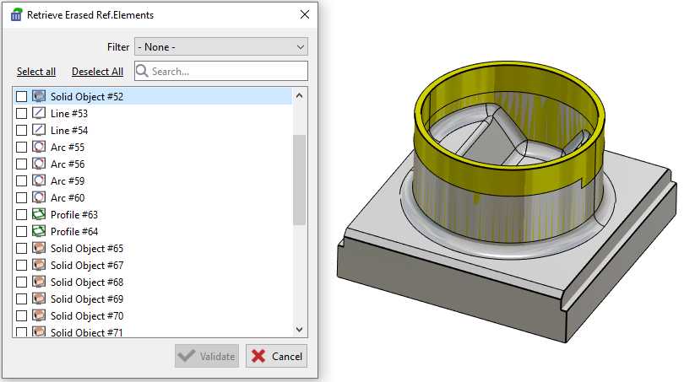
GO2cam V6.09 New Features
Design
Retrieve Erased Ref. Elements
The command to retrieve erased elements is renewed and now offers a dialog box, where you can:
get the whole list of erased elements
filter the deleted elements by types
previsualize them on the screen.
Tick the checkbox to retrieve them and validate.

Slide 17
GO2cam V6.09 New Features
Wireframe
Please read the dedicated document
Requests from VARs included in the Wireframe new module
Bisector: option Z-level
13693 GO2Gmbh
Chamfer / Fillet
Ability to choose a range of corners angles where to apply the element.
10972 GO2Fr
Trim or Extend new function
10056 Jinfo
13867 GO2Fr

Slide 18
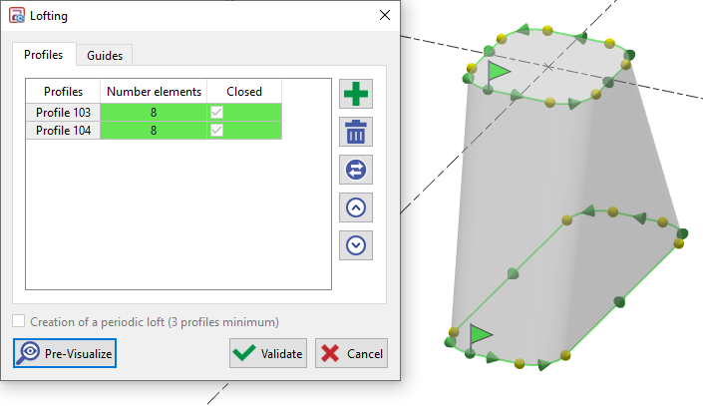
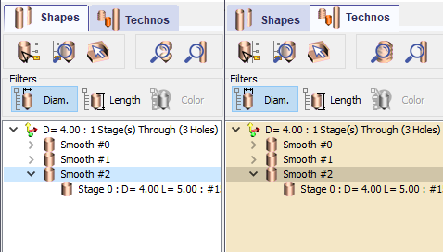
GO2cam V6.09 New Features
Solid Design
Lofting
Holes Recognition
New dialog box for the Lofting command. It enables:
- The selection of profiles and guides
- Add / Delete / Invert / Modify order
- Button to previsualize the result
We added a background color to the Technos tab to highlight the difference between tabs.
GO2 Gmbh
6.08.210

Slide 19
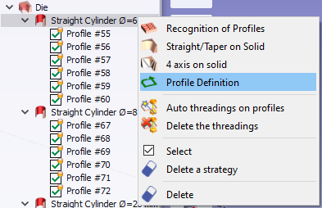
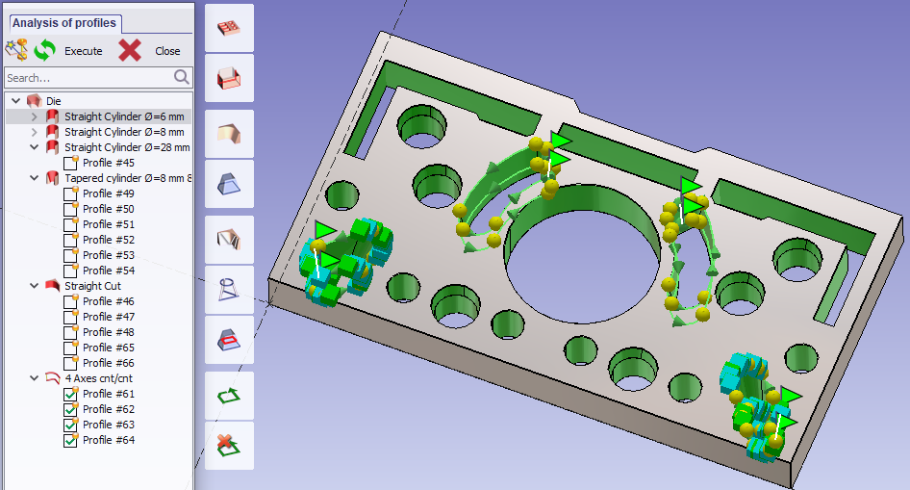
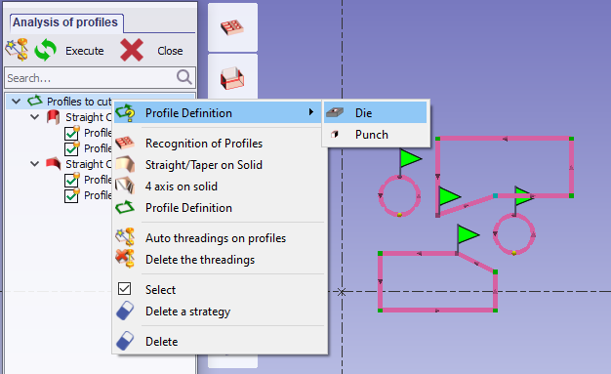
GO2cam V6.09 New Features
Wire EDM Geometry
Recognition of Profiles
The profile definition is accessible from the tree of profiles, in order to create a profile after having defined a Z section.
When a profile is deactivated in the tree, it is now also hidden in the screen.
Application of a color on faces that are still to be treated
When a profile is created by a Z section, the profile definition enables to choose whether it is a die or a punch shape.

Slide 20
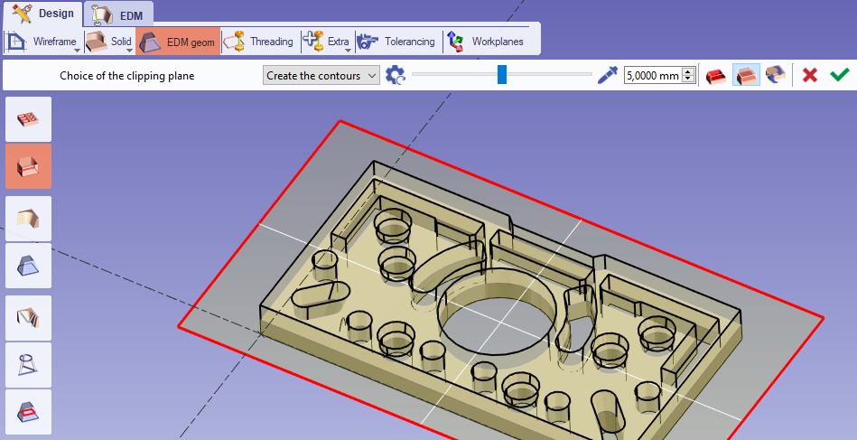
GO2cam V6.09 New Features
Wire EDM Geometry
Solid Section
Geometry Continuity is now automatically applied in the Solid Section

Slide 21
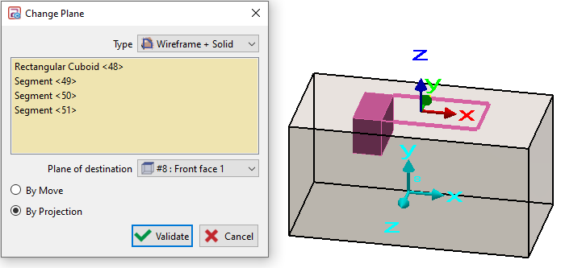
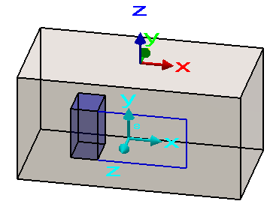
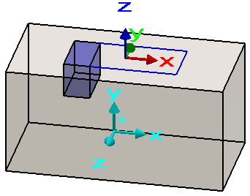
GO2cam V6.09 New Features
Workplanes
Change Plane
New command in the Edit menu which enables to change the workplane of wireframe or solid elements.
2 modes are offered:
- By move:
the new plane is assigned to the elements, which are moved into the plane.
- By projection:
the new plane is assigned to the elements, and the elements stay as they are; their coordinates maybe 3D in that new plane.

Slide 22
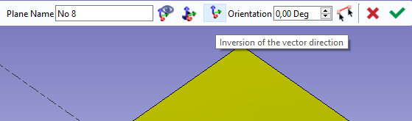
GO2cam V6.09 New Features
Workplanes
Dynamic Creation of Workplane
14055 GO2Fr
Developed Plane
New icon to invert the direction of workplane.
Especially useful while creating a plane on a cylindric surface (cone, cylinder, hole,..)
Ability to give the X orientation by clicking 2 points
The elements projected into a developed plane are not anymore transformed into polygons.
They are kept as arcs and segments, for a better machining result.
11046 GO2Fr

Slide 23
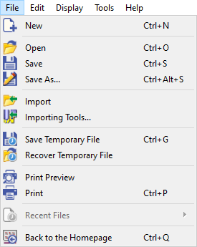
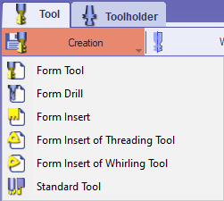
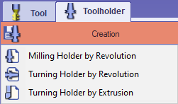
GO2cam V6.09 New Features
Module Forming Tool / Tools Libraries
Temporary Files
Creation of Tools in XML
The commands Save Temporary File and Recover Temporary File are added in this environment.
New commands that enable to save forming tools in XML format. Files are generated in file format *.OUF in XML.
This command is available for :
Form Tool,
Form Drill,
Form Insert,
Form Insert of Threading,
Form Insert of Whirling
Milling and Turning holders by Revolution

Slide 24


GO2cam V6.09 New Features
Module Forming Tool / Tools Libraries
Standardization of Tools
GO2cam tools are updated to be standardized according to:
- ISO 13399: Standard for the Cutting tool data representation and exchange
- GTC format file (Generic Tool Catalog) is a complement to ISO 13399.
GTC has been created because the ISO 13399 standard does not cover all the necessary information.
It provides an efficient exchange between the cutting tool vendor data and the applications.
Sandvik and Siemens are the initiators of the GTC.

Slide 25



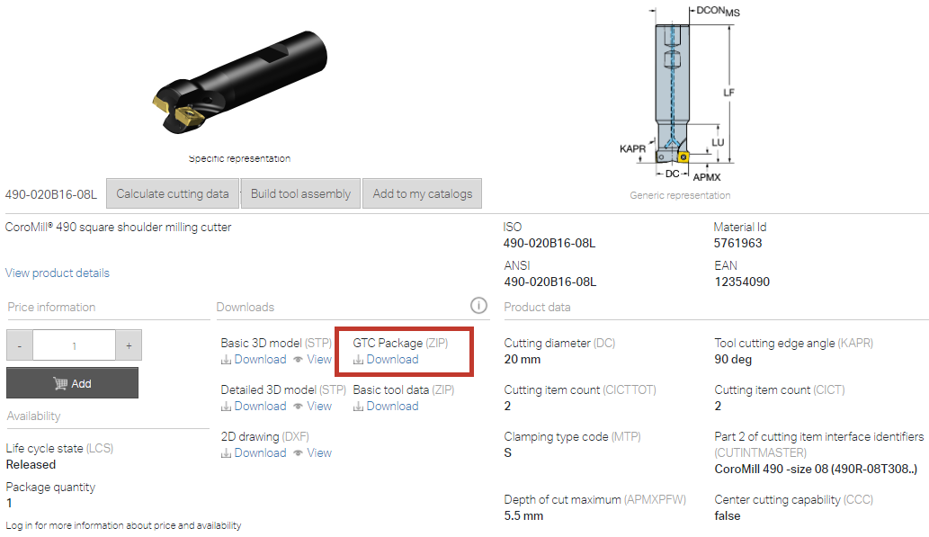
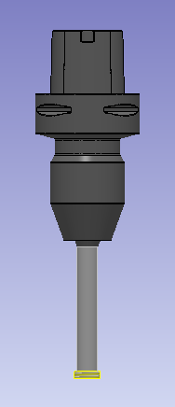
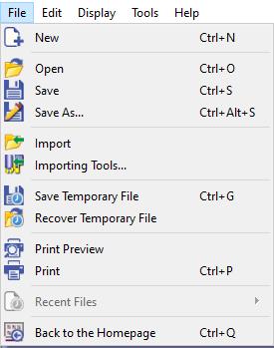
GO2cam V6.09 New Features
Module Forming Tool / Tools Libraries
Standardization of Tools
Ability to read the GTC files to import tools from many databases
Etc.
New command to import tools from database in zip format (from GTC pack)

Slide 26
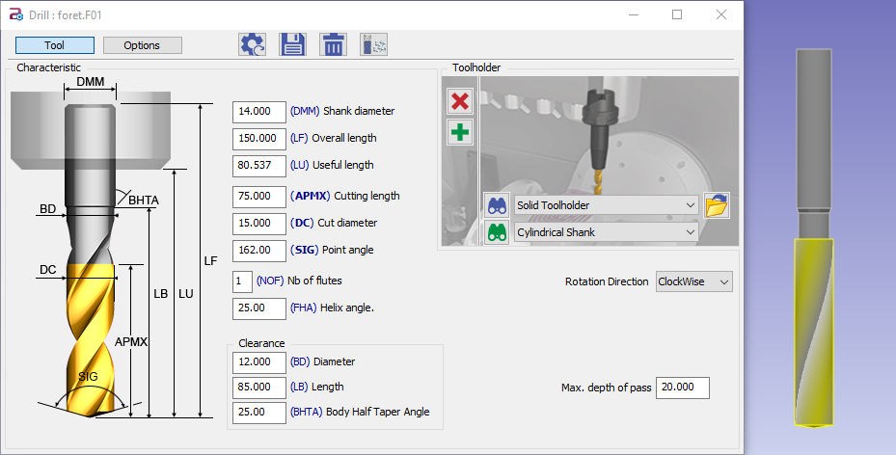
GO2cam V6.09 New Features
Standardization / Homogenization of Tools
Drill
14324 GO2Fr
Clearance parameters are added

Slide 27
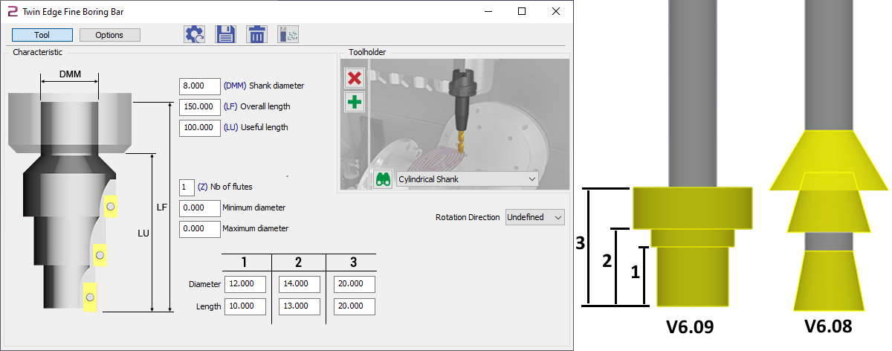
GO2cam V6.09 New Features
Standardization / Homogenization of Tools
Twin Edge Fine Boring Bar
Calculation of stages lengths homogenized with Level Drill
Better tracing of tool

Slide 28
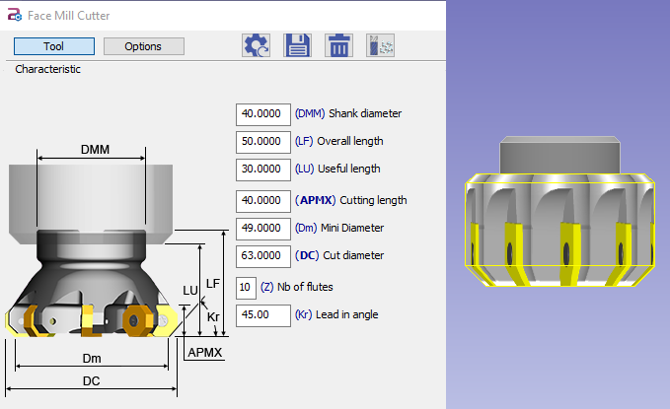
GO2cam V6.09 New Features
Standardization / Homogenization of Tools
Face Mill Cutter
Add of Mini Diameter (Dm) linked to the angle of insert (Kr)
Reference Kr of insert angle is added in the image and in the field
The display of insert is improved
13896 GO2Fr
11288 Saeilo

Slide 29
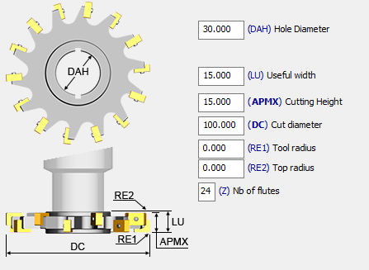
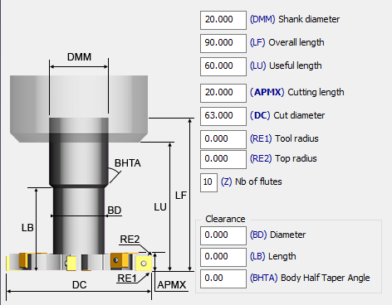
GO2cam V6.09 New Features
Standardization / Homogenization of Tools
Side and Face Mill Cutter
14141 SysT
Woodruff Cutter
14311 GO2Gmbh
- Parameter Tool Radius RE becomes RE1
- Parameter Top Radius (RE2) is added
- Parameter Tool Radius RE becomes RE1
- Parameter Top Radius (RE2) is added
Clearance parameters are added

Slide 30
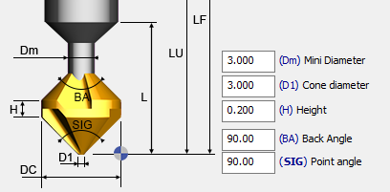
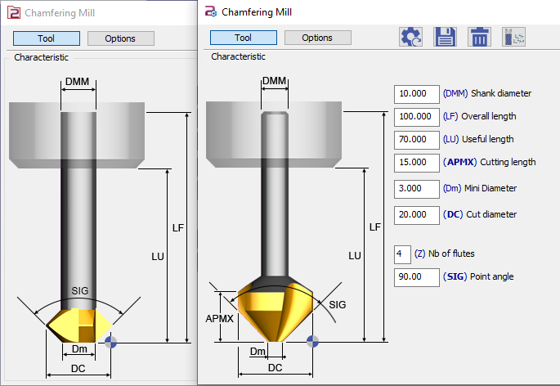
GO2cam V6.09 New Features
Standardization / Homogenization of Tools
Chamfering Mill
14403 GO2Fr
Double Chamfer Cutter
Add of Cutting length (APMX) to define the shoulder on top of cone.
New image of tool
Add of Back Angle (BA)
V6.08
V6.09

Slide 31
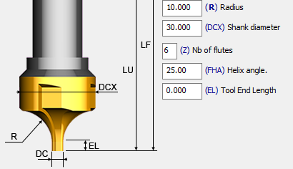
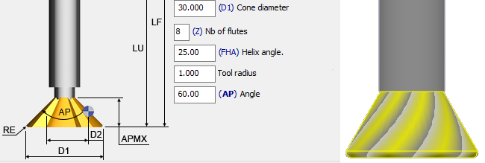
GO2cam V6.09 New Features
Standardization / Homogenization of Tools
¼ Circle Mill Cutter
Inverted Single-Angle
14311 GO2Gmbh
Add of Shank Diameter (DCX)
Add of Tool Radius (RE)

Slide 32
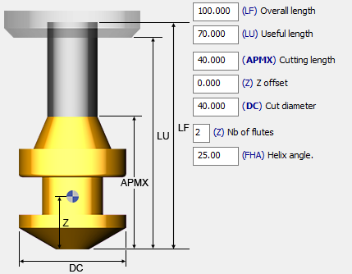
GO2cam V6.09 New Features
Standardization / Homogenization of Tools
14486 Jinfo
Forming Tool / Forming Drill
Add of Overall length (LF)
New behaviour: there is now an automatic calculation of Overall length, Cutting length and Cut diameter according to the profile and dimension of the loaded file *.sym or *.ouf.
These values can be modified later on.

Slide 33
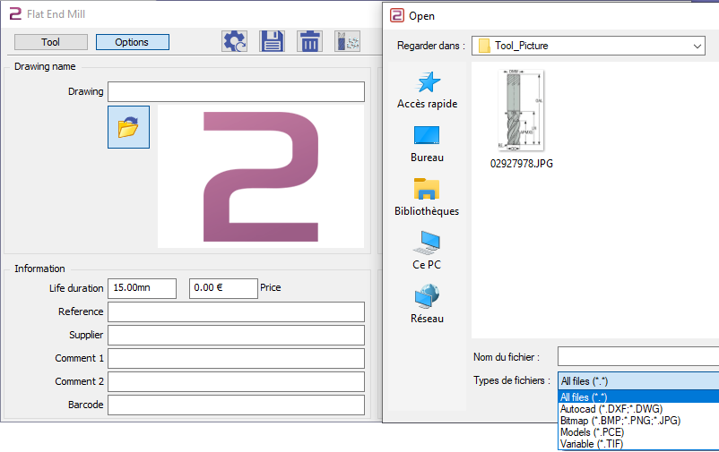
GO2cam V6.09 New Features
Tools Pages
Tool Drawing
Directory for Drawing selection
The file chosen for the tool drawing is automatically copied into the directory ‘tool_picture’.
If the file already exists, you can rename it with a new dialog box (the addressing is not changed anymore!)
DXF/DWG as Tool drawing
It is possible to open a DXF/DWG file as tool drawing.
The file is converted in JPG file formatet and displayed in the dialog.
The jpg file name will be DXF file + tool type extension
Example: drill.DXF -> drill_F20.JPG.

Slide 34
GO2cam V6.09 New Features
Tools Pages
New field Barcode
We added a new option barcode that can be filled by the tools databases interfaces, according to standard EAN : European Article Numbering.
It is also available in the page of holders.
New Coolant option in the Tool Page
6.08.210
GO2Gmbh
New user-field in the Options of tool. --> if a special code is defined in the tool, then it is written in the chosen technology. (number: in coolant nb / Chain in specific coolant)

Slide 35
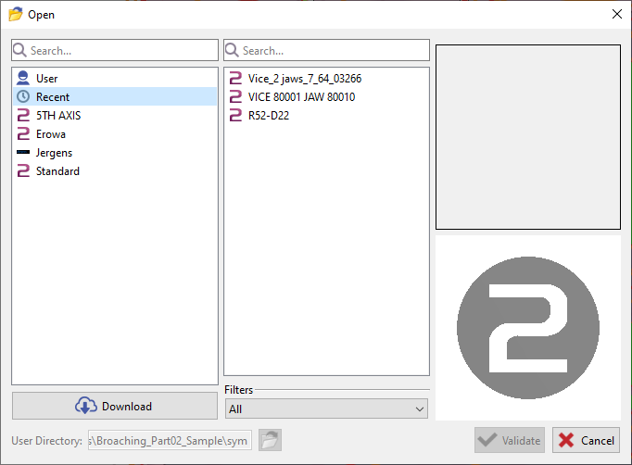
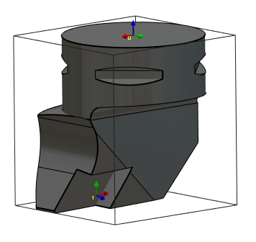
GO2cam V6.09 New Features
Symbols
Import of systems of axis
Download of libraries
14548 Saeilo
New ability to accede to the recent files selected in the libraries of:
Clamping elements (‘Vices and Clamps’)
Solid Holders (in the tools pages)
New possibility to import systems of axis from solid CAD files, by activating the option ‘Wireframe’.
Very useful to create holders by importing STEP files from Sandvik, Iscar databases, etc. It enables to recover the systems of axis for the position of insert for example.

Slide 36
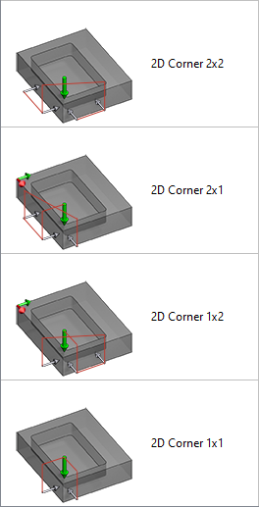

GO2cam V6.09 New Features
Probing
New Cycles for Origins on Stock
14121 Saeilo
14122 Saeilo
2 new cycles:
Rectangular Block by 2 touches in the X axis
Rectangular Block by 2 touches in the Y axis
3 new types of 2D corner probing:
It used to be done in 4 touches, 2 in X and 2 in Y.
Now we can probe a corner with:
2 touches in X and 1 touch in Y
1 touch in X and 2 touches in Y
1 touch in X and 1 touch in Y
→ It is now possible to click wireframe geometry

Slide 37

GO2cam V6.09 New Features
Probing
New Control Report
New control report generated in XML format:
While using ‘Control of part’ probing cycles, all milling post-processors will be able to generate a control report in XML format file with the ISO name and the extension *.MEAS.
The file is automatically created in the same directory as NC files.

Slide 38

GO2cam V6.09 New Features
Probing in Turning modules
GO2Fr
- We can now probe the stock or the turning part in Turning environments.
- We can also select wireframe geometry to force special points to the probing. Then, the point is automatically projected on the solid according to the nearest normal direction.
- If we modify the coordinates of a point that has been probed (SHIFT+click), we automatically project these new coordinates on the solid.
The interest to use Wireframe is the ability to use the silhouette positioned at Y=0.

Slide 39


GO2cam V6.09 New Features
MTE
MTE Tool offset Update
The main purpose of this function is to be able to manage tool gauges by external application. By this way the data can be managed by reading values from machine tool, from tool database, or from other sources.
In GO2cam V6.09, it is possible to update tool gauges by an external executable. To be able to do, the executable path has to be defined in the machine configuration.
If the “Controller communication utility” is defined, a button “Controller” will appear in the “Tools preparation” windows in Machine tooling menu.

Slide 40


GO2cam V6.09 New Features
MTE
MTE Tool offset Update
When Clicking the button “Contrôleur” GO2cam will launch the executable file with two arguments.
First one is the path of xml file generated by GO2cam with information of mounted tools
Second one is the path of xml file waiting by GO2cam to update gauges
Sample : Gauge.exe “C:\GO2cam_Intl\GO2camV609\tmp\toolOut.xml” “C:\GO2cam_Intl\GO2camV609\tmp\toolIn.xml”
The toolIn.xml will have the same format than the toolOut.xml
To modify gauge value, the executable has to modify the concerned values (X,Y,Z) and set the State Attribute to “Modify”'
After treatment, the modified values will have a light green background

Slide 41



GO2cam V6.09 New Features
MTE
Balanced operations: Opposite Tool
In the balanced operations, we added the new possibility to use 2 different tools !
Behaviour:
Program the 4 axis balanced operation with one tool, as usually.
In the tree, in the tool popup, we added a new option ‘Different Opposite Tool’.
Here you can add the second tool or delete the one already chosen.
In MTE control, mount the 2 tools correctly. The list of tools inform about the 2 tools working in the same operation!

Slide 42

GO2cam V6.09 New Features
MTE
Balanced operations: Opposite Tool
Notes:
The balloon tip in the tree gives the information of 2 tools
Standard simulation shows only the main tool! Only MTE simulation shows the 2 tools!

Slide 43

GO2cam V6.09 New Features
Machining Generalities
Opelists
Opelists Ref auto : modification of the Combo box Type of Line
Mute option is modified:
If a cycle of the opelist works with automatic references and that we cannot find the reference in the part, when a cycle is mute, it is automatically deleted and the opelist is calculated (formerly the opelist was set to warning)
14620 GO2cam Gmbh
Customize List of Operations
The number of flutes is now accessible to create and customize the list of operations.

Slide 44

GO2cam V6.09 New Features
Machining Generalities
14367 Techsoft
Material File
Stock Dialog
We added the description of the materials ISO groups in the list; Cast Iron for K grade for example.
Jump with TAB key is improved
14263 GO2cam Gmbh
Toolpath Simulation
Once launched, only the space bar and esc key had some effect: in V6.09, you can now use the buttons in the dialog to stop the simulation or change the speed for instance.

Slide 45


GO2cam V6.09 New Features
Machining Generalities
Picking symbol
While selecting machining operations, new ability to define ‘Bottom Z’ by clicking the symbol extremities.
It can be very useful to adjust the depth of machining according to the holding elements.
Altitudes and depths values are persistent !
Technology Page
Icon for the spindle rotation

Slide 46
GO2cam V6.09 New Features
Milling
Stock Calculation
New calculation:
Multi Threading is now used for the standard stock calculation. The more cores you have on the processor, the more rapid it is.
The algorithms are optimized.
→ Calculation time is especially improved for 5 axis simultaneous toolpaths.
Part | V6.08 PC1 PC2 |  | V6.09 PC1 PC2 | V6.09
Finish facing ae1_standard.PCE | 4:49 | 7:18 | 1:27 | 1:31
Finish facing ae2_standard.PCE | 3:26 | 3:26 | 0:37 | 0:41
Finish Z level ap0.3_standard.PCE | 0:51 | 0:51 | 1:01 | 0:58
Rough facing ae3 ap3_standard.PCE | 0:08 | 0:10 | 0:03 | 0:04
→ Faster Calculation + Better Calculation

Slide 47

GO2cam V6.09 New Features
Milling
14236/14380 GO2Fr
Pockets: Gouge Check and Movement Options
When Gouge check is set to YES, we consider gouge check only for the 1st and last motions, and the intermediate motions defined in Movement page are now respected.

Slide 48







GO2cam V6.09 New Features
Milling
Contouring
GO2Fr
Ability to define a negative radius value, in order to machine inverted fillet for a ‘slot’ with a Side and Face cutter.
Altitude on the bottom has a new name Input Altitude, because it now includes new options.
V6.08
V6.09
On bottom
Cavity
On tool top

Slide 49


GO2cam V6.09 New Features
Milling
Pocket
GO2Gmbh
Ability to use the ‘Inverted Single-Angle’ cutter with Pocket operation.
The purpose is to machine a bottom of pocket and tapered sides of pocket in one go.
This is why some parameters of pocket are automatically set and greyed out: Z step and steps ajustment, and Z allowance.

Slide 50

GO2cam V6.09 New Features
Milling
Features
Chamfering
GO2cam France
We can now pick an altitude by clicking directly a solid face.
If the face is not flat, we analyze the bounding box and we keep Zmax or Zmin according to the chosen icon.
Face Mill cutter is added to the chamfering list of tools. Useful for Face mill with 45° inserts that can break angles

Slide 51

GO2cam V6.09 New Features
Milling
3D Correction for 5Xs isoparametric
7774 Jinfo
New option 3D correction
GO2cam calculates contact points and the vectors normal to the surface.
Post-processors do not manage this 3D correction right now.
Toolpath
Contact

Slide 52


GO2cam V6.09 New Features
5 Axis Expert
Persistency of Solid Faces
New tools
Solution Korea
All the faces and surfaces are now updated during the toolpath calculation. If we move a solid or modify a face and that it is used for gouge checking, the toolpath will take it into account and be modified automatically.
Management of 2 new tools:
Side end mill cutter
Woodruff cutter.
Below, the bottom face is used for gouge checking: it is higher on the right side, where the toolpath is automatically modified.
Precision
The Curve tolerance option is now used for the meshing of Parasolid surfaces.
In V6.08, this value ws fixed to 0.01 and not modifyable.

Slide 53

GO2cam V6.09 New Features
Wire EDM
Straight cut with Stop
14185 GO2Gmbh
The stop is now applied even if the stop length > last element length

Slide 54



GO2cam V6.09 New Features
Turning Stock
13979 Cam-Team
14514 GO2Gmbh
Turning stock manages axial milling cycles
The red shape is machined by a pocket operation
Facing and Reaming take the stock after pocketting
When an axial milling cycle has consequences on the turning stock shape, it is now possible to take it into account for stock calculation of next turning operations.
For this, set on ‘Update of turning’ into the solid stock calculation option for each milling operation.
This option is available only for milling cycles operating in the axial plane.

Slide 55

GO2cam V6.09 New Features
Turning Stock
Turning Stock Rendering Texture
New rendering texture on the stock for the following machining operations:
Tapping
Die Threading,
Thread Whirling
Knurling
Standard Threading
Profile threading.
We can check the step and the direction of rotation of threads.
Rendering texture are also available in dynamic simulation for Tapping, Die Threading, Thread Whirling and Knurling.

Slide 56


GO2cam V6.09 New Features
Turning
P Point Calculation
Renew of P Point Calculation in all the turning cycles:
Toolpath calculation and simulation are not done anymore in Center Toolpath.
V6.08
V6.09

Slide 57


GO2cam V6.09 New Features
Turning
P Point Calculation
Rapid Motions are correctly managed, with X and Z rectangular movements and not direct motions as formerly.
The Balanced Roughing and Balanced Finishing are also improved to manage correctly their moves in P Points Toolpath.
All the Approach/Return points are considered in P Points, if selected option. The coordinates of the given points are now generated in NC file.
Gouge check calculation is completely renew.
List of resulting improvements:
Dynamic and Toolpath Simulations renew,
Coordinates given at P Point,
No more parasite motions.
V6.08
V6.09

Slide 58



GO2cam V6.09 New Features
Turning
Bi-edges Tools
14285 SysT
10699 Jinfo
In the Turn Face Cutter page, new parameter to calculate P Point position to standard or Bi-edges.

Slide 59

GO2cam V6.09 New Features
Broaching
14224 Saeilo
Management of Grooves wider than Tool
The aim is to program several lateral passes in Y, if the groove if wider than the tool
We added 2 parameters to calculate the lateral passes:
in the tool page: Cutter width (CW)
in the strategy: Slot width

Slide 60


GO2cam V6.09 New Features
Broaching
14224 Saeilo
Improvements
Improvement of rapid toolpath while indexing with a new motion of positioning to enable to turn round as on the machine
New option Cone Angle to enable a sloped return motion. Especially useful when the slot is blind.

Slide 61



GO2cam V6.09 New Features
Turning
turnyuGO
14192 GO2Gmbh
Roughing
13911 GO2Fr
New Management of Chip Breaking
Add of the dwell for chip breaking in the motions of Profile Retraction type:
- we delete the retracts on the profile following
- we activate the dwell on the profile retraction if the retract is set to 0
- We activate the dwell if we do not machine pockets.
We use a retract to 45° to manage chip breaking. As for roughing, we use the length of cut to run the retract and a retract value. Leadin can be done either linear or circular.

Slide 62



GO2cam V6.09 New Features
Turning
Groove Finishing
13639 GO2Gmbh
Endless Screw
New method ‘in flat bottom’ to calculate the overlap, in order to minimize the toolpath.
Finishing of a Screw: we added the finish parameter such as in the grooving operations

Slide 63

GO2cam V6.09 New Features
Turning
Centering / Tapping
Drilling
Strategy dialogs are renewed
Tapping
Management of the 4th point of a level drill has been added.
New parameter Dwell
Centering / Drilling
Management of live tools rotation coupled with the spindle rotation. Used to respect the cutting conditions for small tools by adding tool rotation and spindle rotation.

Slide 64


GO2cam V6.09 New Features
Turning / Swiss Machining
Roughing
14098
New parameter, dedicated to swiss machining: Deburring length is useful to cut the chip on the bar to avoid injuring the guide bush.
Synchro
New Techno cycle to define synchro between 2 cycles. More flexible and easy to use than the Synchro diagram.

Slide 65



GO2cam V6.09 New Features
Turning / Swiss Machining
4 new cycles
13924 Saeilo
  Form Finishing
Finishing operation done forming tools, especially for Back turning tools.
*.sym and *.ouf tools can be used.
*.ouf is a new format file to draw forming tools and save them into xml format.
Libraries of ISCAR and KYOCERA tools are available.
  Knurling
Knurling is a machining operation that consists in creating combination of horizontal, vertical or crossing lines on the surface of material.

Slide 66





GO2cam V6.09 New Features
Turning / Swiss Machining
4 new cycles
  Die Threading
Operation similar to a tapping operation but for a shaft.
Use of a threading die tool.
  Thread Whirling
Thread whirling is similar the a thread milling process, except that inserts are mounted on the inside of a cutting ring.
The ring turns around the part to machine the thread in one pass
Thread whirling is a productive method and often used for special thread forms that need to be produced quickly and at high tolerances. Typical components are medical bone screws, implants, feed screws, worm gears, and other micro components.

Slide 67




GO2cam V6.09 New Features
Swiss Machining Modules
Dedicated to sliding headstock
- 2 new modules
Swiss Machining Classic: turning + milling + 4 axis with C and Y
Swiss Machining Expert: Classic + B axis + 3D milling
- Process with a Wizard (such as MPM) that will enable the choice of machine.
- Machine File
New Machine File Format: *.MCS
New Standard PPs: *.SPS

Slide 68

GO2cam V6.09 New Features
NC File
Former standard PPS (<V6) are now archived in ppstd\lib.
The list of available PPs is reduced at first sight.

Slide 69

GO2cam V6.09 New Features
Workshop documents
Workshop Doc and PDF workshop doc are not anymore external application, there are fully included in the software.
Consequently, running those commands is much more faster and reliable than used to be.
Also, it deals with the part on the current session!
Customized Documents
In the page Customized Documents, the checkbox are greyed out if the corresponding XML (A3H.xml , ...) are not in the directory Model.
The bitmap is also now displayed in the list of available pages

Slide 70


GO2cam V6.09 New Features
Workshop documents
Tools Pages
Display of tools is improved.
A new option enables to choose whether you want 3D model or just an image.

Slide 71

GO2cam V6.09 New Features
User Workshop documents
3D Display
Homogenizing of User Workshop Docuemnt compared to standard command regarding the display of part in 3D
- UWD has now the toolbar to hide/display the different types of solid
- The screenshot in background is shown while deactivating the 3D mode
- The default view is ZX for turning part

Slide 72


GO2cam V6.09 New Features
User Workshop documents
Pages to be filled
User questions and Title block now appear in a combo box.
We do not create severak pages anymore if the number of questions was exceeding 12.
The answers to the user questions are now saved in tmp/documentationAnswer.ini for each model, to be suggested the next time by default

Slide 73

GO2cam V6.09 New Features
Workshop documents / UWD
Pages Manager
GO2Fr 13911
We can now change the order of pages by the popup menu. The list must be ordered by first column if you want those items to appear.

Slide 74
GO2cam V6.09 New Features
GO2cam for SW
- Save Button is added on top bar
- Ability to keep the CAD tree into the CAM menu
For this, you need to open the file called ini\PlugIns.ini in the directory where is installed the plugin (for instance C:\GO2cam_Intl\GO2camV608\System\GO2SW).
Check the option FeatureManagerOpen=0. Set it to 1 to keep the tree and launch the software again.
- Request to have the ability to copy some / or all cycles from one GO2cam instance into another. Copy opelist directly from file does not work with SLDPRT files.

