Slide 1

Swiss machining
GO2cam V6.09
16/02/2022

Slide 2




MEETING RULES
Please Mute your Phone
Please Keep your mic Muted
Keep Chat Pertinent & Clean

Slide 3


Information
You will participate to this presentation.
Keep your smartphone near you
Be sure that you have QR code apps

Slide 4
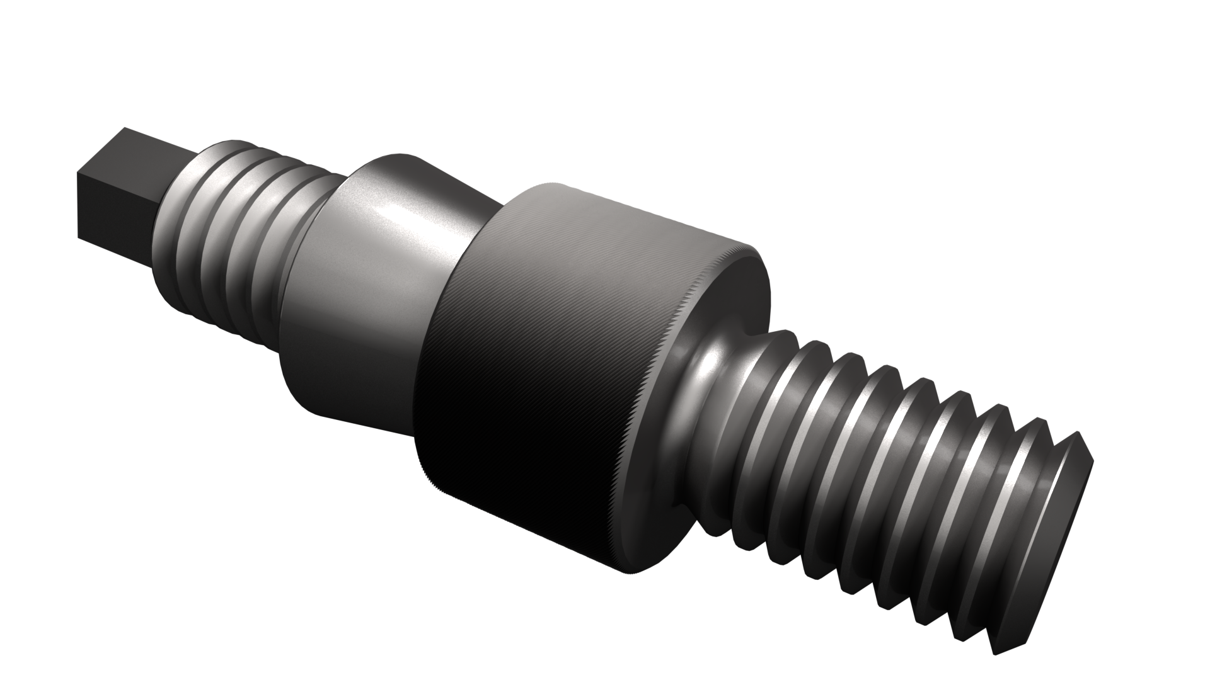
Summary
New swiss machining module
New cycles
Improvements
New packages
Migration process

Slide 5
Summary
New swiss machining module
New cycles
Improvements
New packages
Migration process

Slide 6
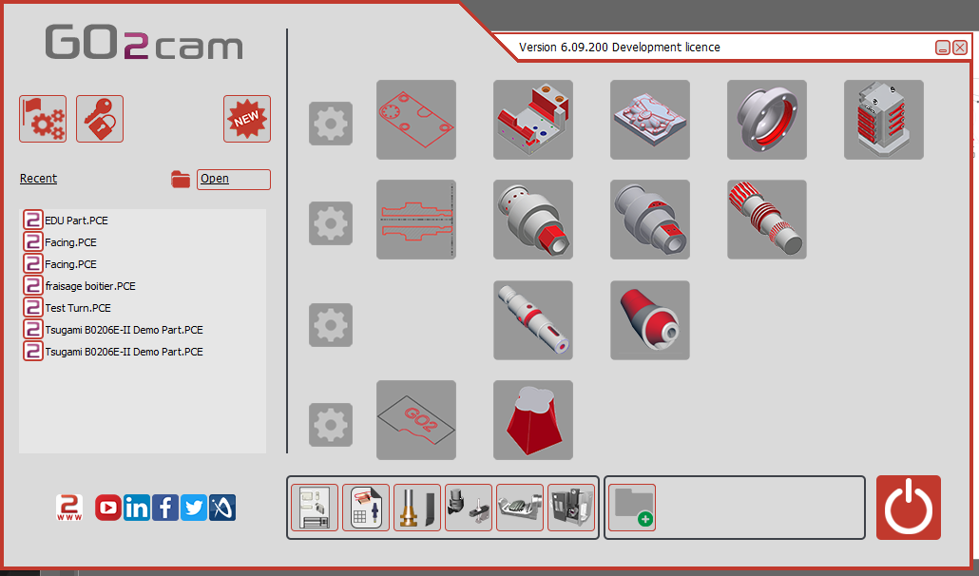
New swiss machining module
Two new entries in the workshop

Slide 7
New swiss machining module
Swiss machining Classic
  4 axis capabilities
Swiss machining Expert
  5 axis capabilities

Slide 8
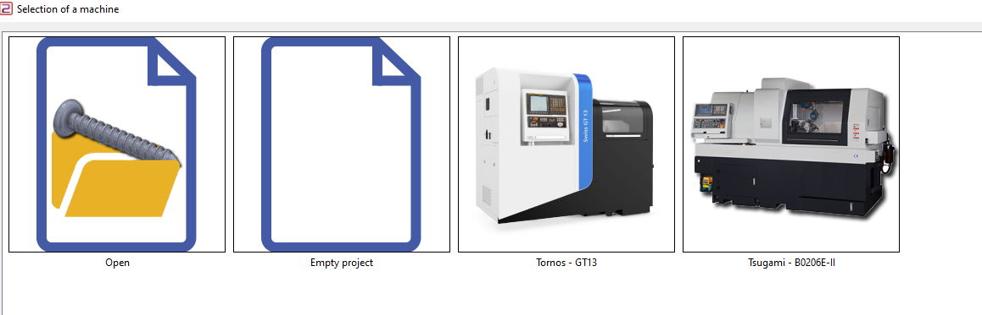
New swiss machining module
Wizard to select machine when new project begin

Slide 9
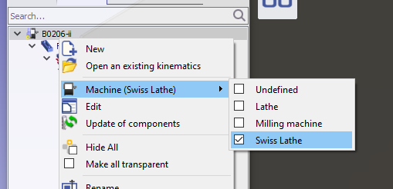
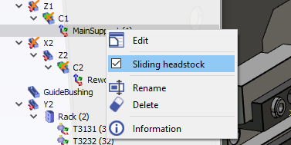
New swiss machining module
The kinematic file need to be specific
  Swiss Lathe as type of machine
  Sliding headstock on the main support

Slide 10
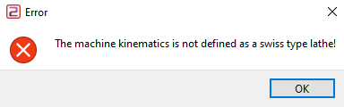
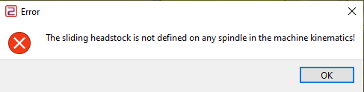
New swiss machining module
If one of those condition is not respected MTE simulation doesn’t run

Slide 11
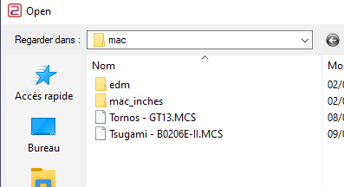
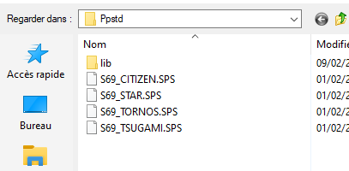
New swiss machining module
Swiss machining module use
  « .MCS » file as machine file
  « .SPS » as standard post-processor

Slide 12
Summary
New swiss machining module
New cycles
Improvements
New packages
Migration process

Slide 13
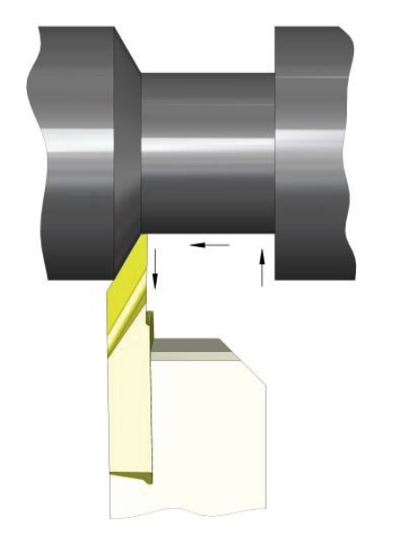

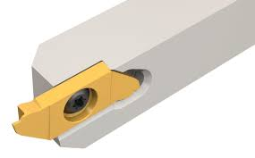
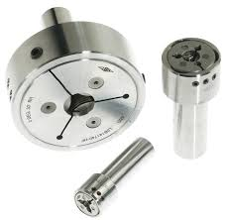
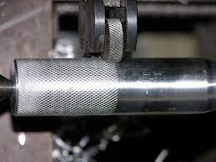
New cycles
Four cycles
  Thread Whirling
  Die threading
  Knurling
  Form finishing

Slide 14
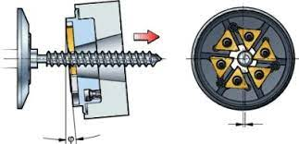
New cycles
Thread Whirling application
  Creation of thread with one pass with specific tool
  Long part
  No need to back the part in the guide bush

Slide 15
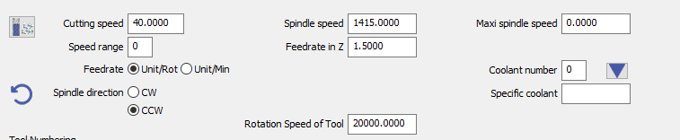
New cycles
Thread Whirling application
  The part and tools have rotation speed
  The speed should be synchronized and the rules are given by tool provider

Slide 16
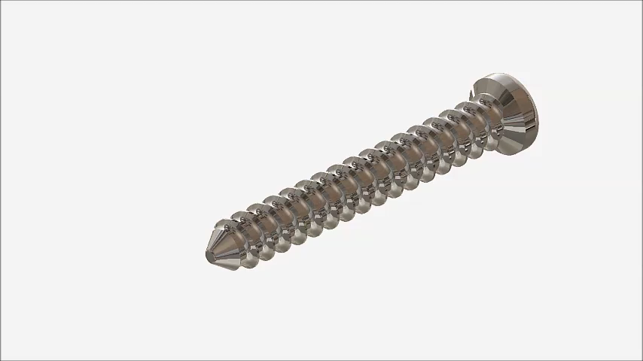
New cycles
Thread whirling

Slide 17
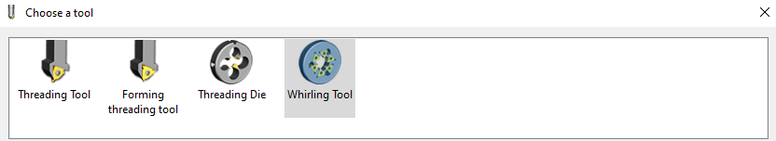
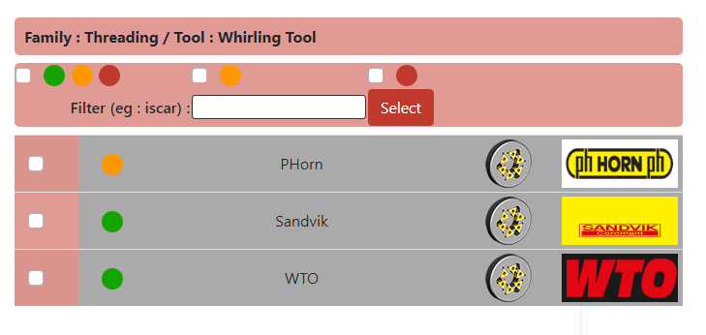
New cycles
Thread Whirling
  Tool

Slide 18
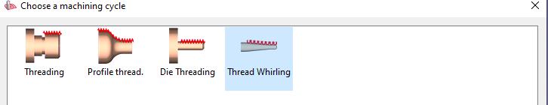
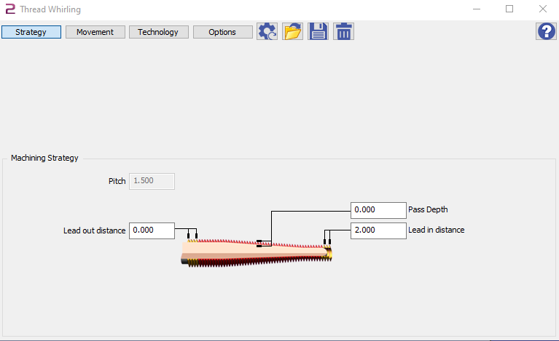
New cycles
Thread Whirling
  Threading cycle family

Slide 19
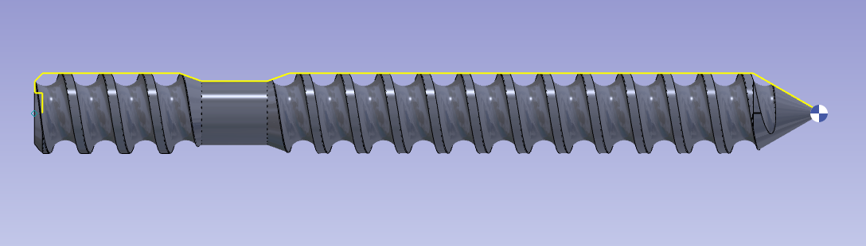
New cycles
Thread whirling

Slide 20
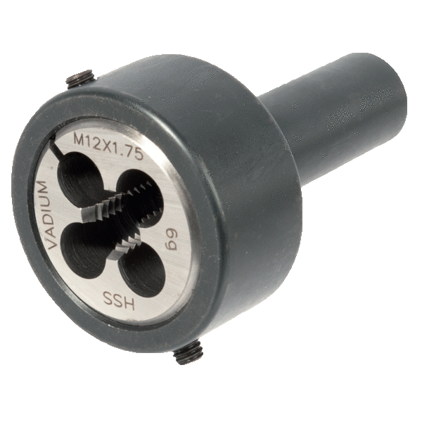
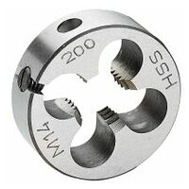
New cycles
Die Threading application (similar than Thread Whirling)
  Creation of thread with one pass with specific tool
  More simple cycle
  No need to back the part in the guide bush
  No radial effort on part

Slide 21
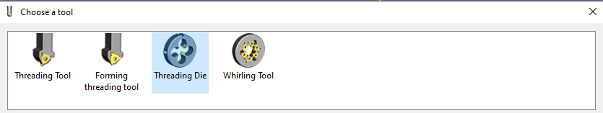
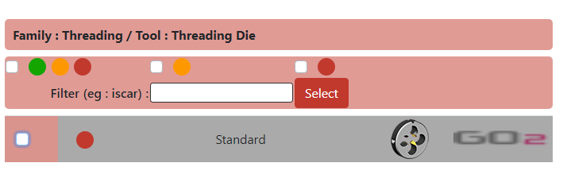
New cycles
Die Threading
  Tool

Slide 22
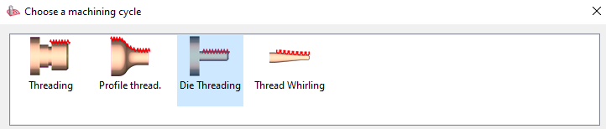
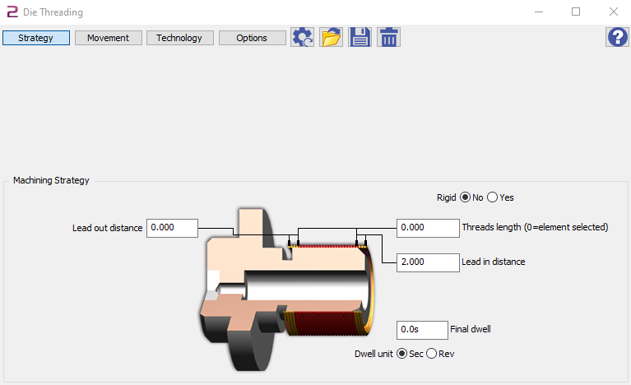
New cycles
Die Threading
  Threading cycle family

Slide 23
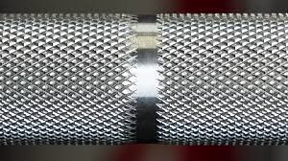
New cycles
Knurling
  Create small ridges along a part

Slide 24
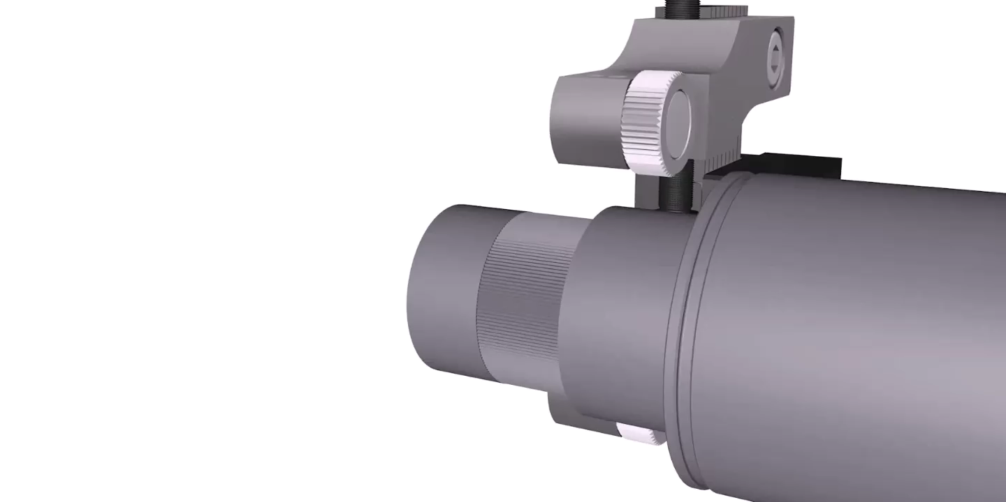
New cycles
Knurling

Slide 25
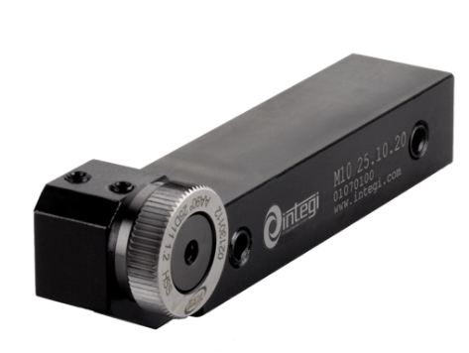
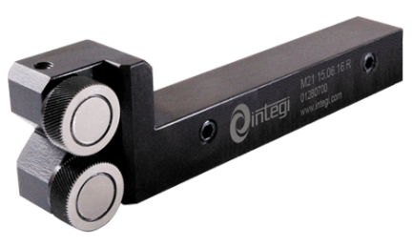
New cycles
Knurling
  Tools with one roll
  Tools with two rolls

Slide 26
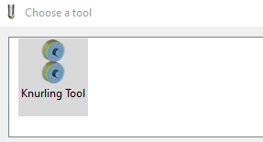
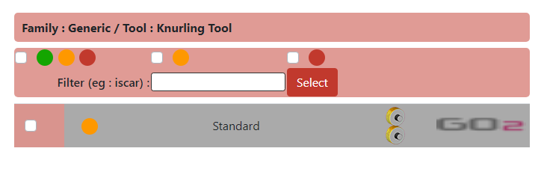
New cycles
Knurling
  Tool

Slide 27
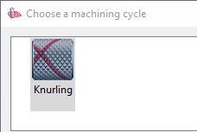
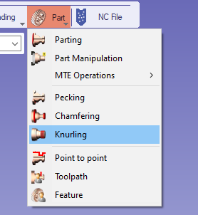
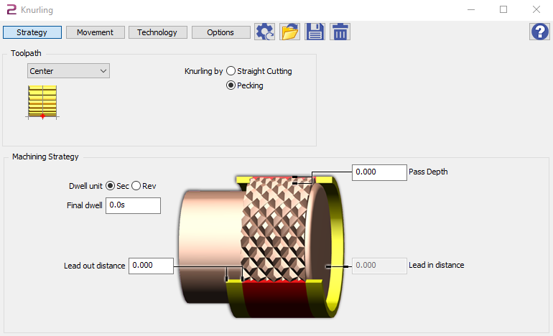
New cycles
Knurling
  Part cycle

Slide 28
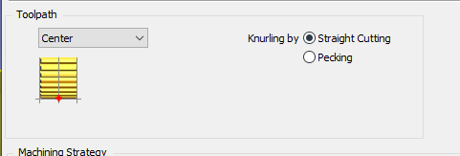
New cycles
Knurling
  Straight Cutting
  Pecking

Slide 29
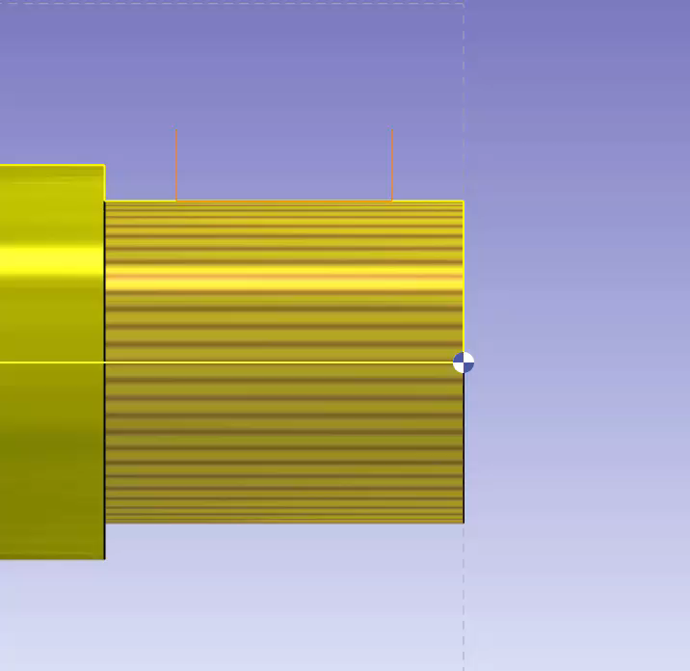
New cycles
Knurling
  Straigth Cutting
    The tool plunge and turn the whole profile

Slide 30
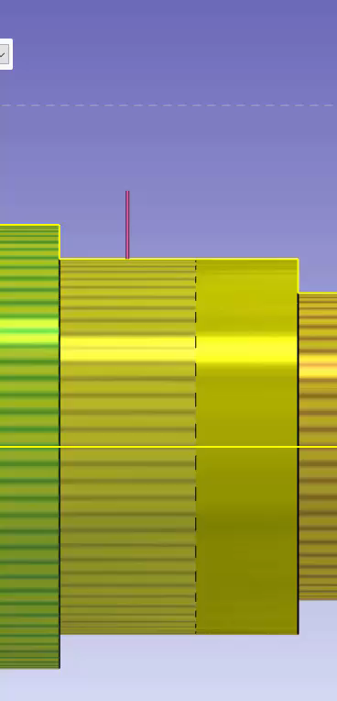
New cycles
Knurling
  Pecking
    The tool plunge at the end of profile element

Slide 31
New cycles
Form finishing
  Use specific tool to have
    low radial forces
    better result
    better chip-control

Slide 32
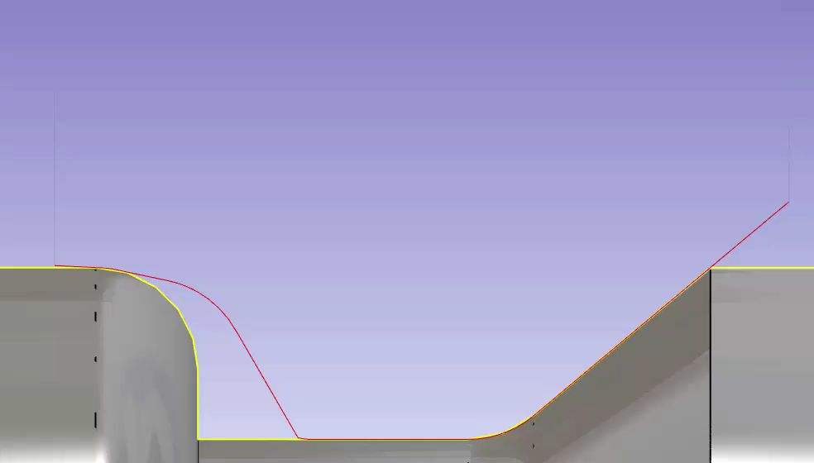
New cycles
Form finishing
  The cutting edge can change during the machining

Slide 33
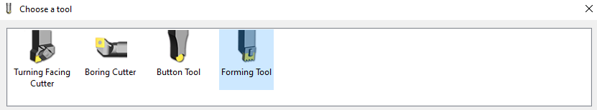
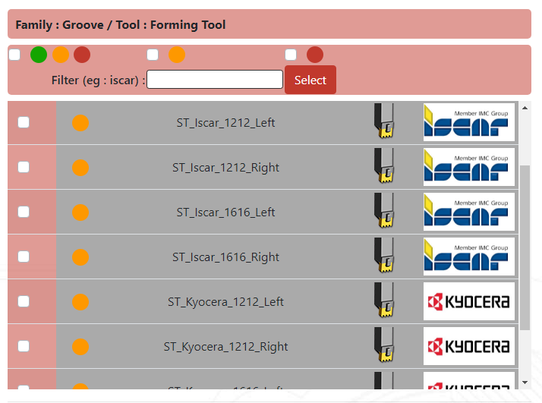
New cycles
Form finishing
  Forming tool

Slide 34
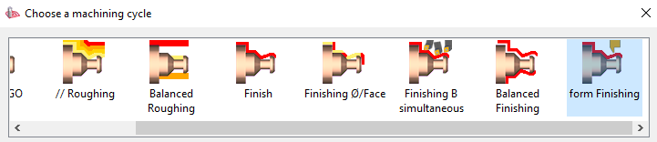
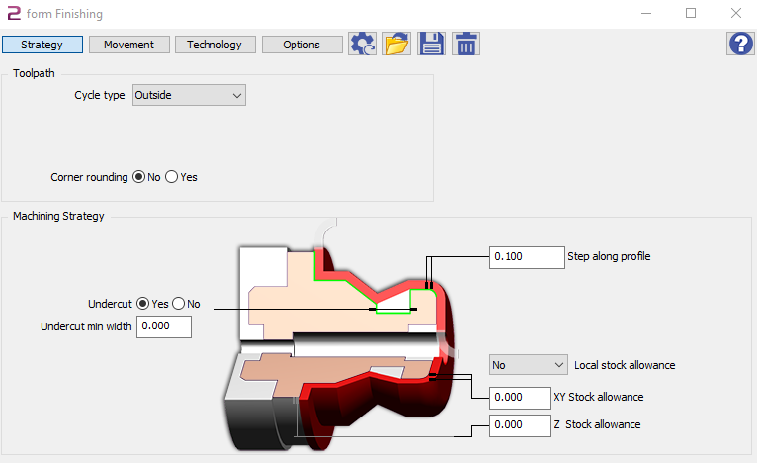
New cycles
Form finishing
  General Ope : form Finishing

Slide 35

New cycles
Quiz 1

Slide 36

New cycles
Quiz 1 : Result
Result page
Notes:
https://forms.office.com/Pages/AnalysisPage.aspx?id=HdI5bidnrkWv77YrFsQPkK0XKJzkRodLsxAf1LdrV6xUNzJGUFFYRDBNQUNTNUxVUTlLVlhHQlpKTCQlQCN0PWcu&AnalyzerToken=lzp343HL1bY2PlRwQtwiaKpQoUUkTnwI

Slide 37
Summary
New swiss machining module
New cycles
Improvements
New packages
Migration process

Slide 38
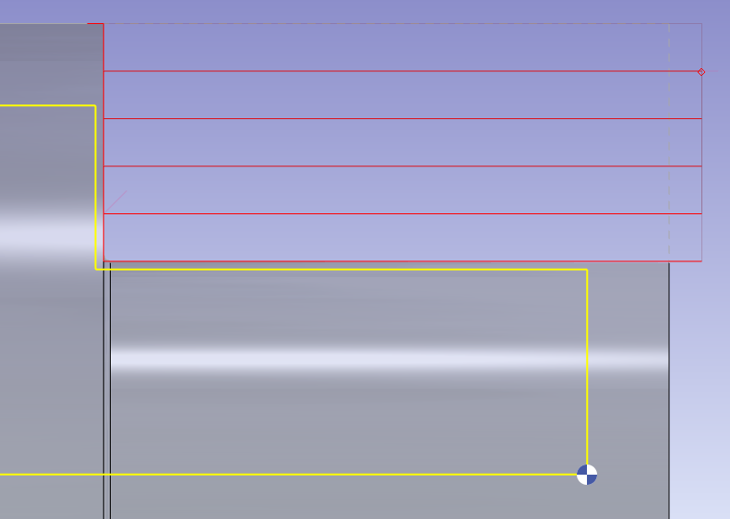
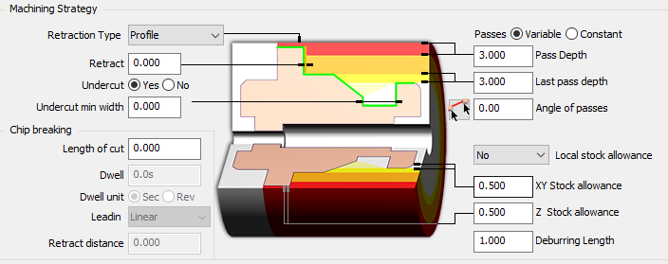
Improvements
New option in roughing cycle
  Deburring Length
  Prevent guide bush damage

Slide 39

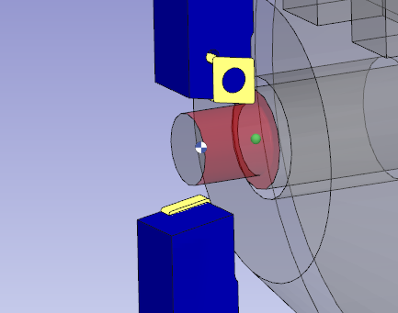
Improvements
Synchronization on toolpath

Slide 40

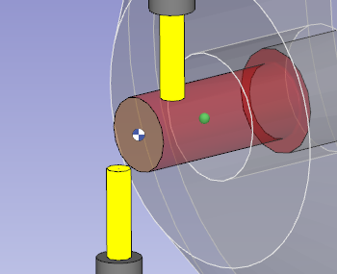
Improvements
Synchronization on toolpath

Slide 41
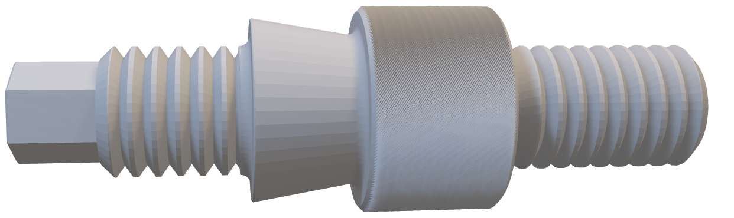
Improvements
SM22 Demo part

Slide 42
Summary
New swiss machining module
New cycles
Improvements
New packages
Migration process

Slide 43
New packages
Swiss machining module will be sale under 3 packages
  Swiss Machining Classic (SMC)
  Swiss Machining Expert (SME)
  Swiss Machining Full (SMF)

Slide 44
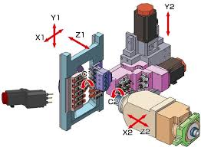
New packages
Included modules in SMC
  Swiss machining classic
  Step reader
  4 axis GO2cam cycles
  MTE simulation
Optional modules in SMC
  HMF
  User workshop document
Machine range
  2 channels application
  4 axis simultaneous

Slide 45

New packages
Included modules in SME
  Swiss machining expert
  Step reader
  4 axis GO2cam cycles
  MTE Expert simulation
Optional modules in SME
  HMF
  User workshop document
Machine range
  2 channels application
  4 + 1 axes positioned

Slide 46

New packages
Include module in SMF
  Swiss machining expert
  Step reader
  4 axis GO2cam cycles
  5 axis GO2cam cycles
  Module works 5 axis cycles
  MTE expert simulation
  HMF
  User workshop document
Machine range
  3 channels application
  5 axes simultaneous

Slide 47
New packages
 | STEP | Swiss classic | Swiss expert | 4 axis GO2 | 5 axis GO2 | 5axis Mow | MTE | MTE EXP | DOC | HMF | Channels | Driven axes
SMC | * | * | X | * |  |  | * |  | O | O | 2 | 4 simul ZYXC/channel
SME | * | * | * | * | X | X | * | * | O | O | 2 | 4 simul XYZC + 1(A or B)/channel
SMF | * | * | * | * | * | * | * | * | * | * | 3 | 5 simul XYZCA/channel
* : included
X : not allowed
O : optional

Slide 48

New packages
Quiz 2

Slide 49

New packages
Quiz 2
Result page
Notes:
https://forms.office.com/Pages/AnalysisPage.aspx?id=HdI5bidnrkWv77YrFsQPkK0XKJzkRodLsxAf1LdrV6xUODNBSVAySTJCNURYWVM1UEZMVkxXSFo0VCQlQCN0PWcu&AnalyzerToken=lzp343HL1bY2PlRwQtwiaKpQoUUkTnwI

Slide 50
Summary
New swiss machining module
New cycles
Improvements
New packages
Migration process

Slide 51



Migration process
The existing swiss type machine will continue to work in TurnMill module of GO2cam in the V6.09. It will no longer work with the future V6.10. You have to be in the Swiss Machining module to use swiss machine type.
V6.08
V6.09
V6.10
TurnMill module
Swiss Machining module

Slide 52


Migration process
MCG modification
  Swiss Lathe for machine Type
  Sliding headstock on the main support

Slide 53


Migration process
Open PCE file with defined machine
« Save as » the machine to have a MCS machine file definition

Slide 54


Migration process
Post-processor modification
  Edit the post processor
  Change the standard base from S67_ to S69_
  Save the pp

Slide 55

Migration process
Quiz 3

Slide 56

Migration process
Quiz 3
Result page
Notes:
https://forms.office.com/Pages/AnalysisPage.aspx?id=HdI5bidnrkWv77YrFsQPkK0XKJzkRodLsxAf1LdrV6xUN1FLRDRFUDlKQ0dIWUxCSE5SNFhHS0swViQlQCN0PWcu&AnalyzerToken=lzp343HL1bY2PlRwQtwiaKpQoUUkTnwI

Slide 57


Migration process
Why is the « Dahu » special ?
It has shorter legs on one side, to be able to move on the mountain.

Slide 58
THANK YOU
139 rue Vendôme, 69006 Lyon, France

