Slide 1

GO2cam V6.10
List of New Features
The features added in 6.09.202 are highlighted with
6.09.202
139 rue Vendôme, 69007 Lyon, France

Slide 2

GO2cam V6.10 New Features
Introduction / Contents
4 main new topics were presented during VAR Meeting :
Milling Features
Solid Design
Patterns for Swiss Machining
NC Control
Those topics will be explained through courses and tutorials : coming in the next weeks!
Replays of the VAR Meeting presentations are available and indicated by the symbol
VM
More than 150 other new features are available in GO2cam V6.10.
The full list is given in the present document.
40 videos dealing with about 100 new features are available.
They are pointed out in the
present document with the symbol
10
The number is the lesson number in GO2cam Academy
(we advise you to watch everything anyway!)

Slide 3
GO2cam V6.10 New Features
Advises for Updates
Windows 8 and W8.1 not supported anymore: W10 and W11 are supported.
The Users files for Preferences (*.OPG) and Options (*.OPT) are not compatible with new version 6.10!
A new mechanism is in place, with one unique type of file (*.ini).
Please read more in Slide 14
The management of addressing directories is also greatly modified; please check the customers configurations.
Please read more in Slides 21 and 22.
Management of Users files
The Users files are not saved anymore in the directory Dat, but in the directory ini.
Wshop_CMD.USR (customize homepage)
Mnu_proc.USR (customize menus)
Res_gamme.USR (customize list of operations)
GO2operator.USR (file for definition of users and access to GO2operator)

Slide 4
GO2cam V6.10 New Features
Advises for Updates
The Customized toolbars files are also saved in ‘ini’ directory.
Warning: the files are not compatible from V6.0x to V6.10 either if you rename them.
Please check the table of corresponding names.
Name in V6.09 | Name in V6.10 | Corresponds to…
TBR_SPD0.USR | tbr_product_mill_classic.usr | Mill Classic
TBR_SPD2.USR | tbr_product_edm_classic.usr | Wire EDM Classic
TBR_SPD3.USR | tbr_product_turnmill_classic.usr | Turnmill + C Axis Turnmill Classic
TBR_SPD4.USR | tbr_product_mill_expert.usr | Mill Expert
TBR_SPD5.USR | tbr_product_document_model.usr | User Workshop Document
TBR_SPD6.USR | tbr_product_drawing.usr | Layout Design
TBR_SPD12.USR | tbr_product_turnmill_expert.usr | Turnmill Expert
TBR_SPD16.USR | tbr_product_andrea.usr | Mill Classic + Boring Head
TBR_SPD17.USR | tbr_product_swissturn_classic.usr | Swiss Machining Classic
TBR_SPD18.USR | tbr_product_swissturn_expert.usr | Swiss Machining Expert

Slide 5
GO2cam V6.10 New Features
Hardware
Software Update
New error messages in case of download issue
GO2cam Gmbh - 15066
While running the update of software, GO2cam will now make a test to check if an internet connection is available on the PC. Without connection, following message will be displayed:
« No Internet connection on this computer. Impossible update recover. »
If the internet connection is available, GO2cam will check then the access to the FTP download site. If the site does not answer, there may be 2 reasons : either FTP site is out of connection, or the local port 21 is blocked. In this case, following message will be displayed:
« The update site does not answer. Either it is out of order, or you FTP 21 port is blocked by your routeur or firewall »
Graphics
GO2cam Gmbh - 15243
New error message if the computer system is not able to display correctly OpenGL 3.0.
(Before, GO2cam tried to display and sometimes switched to openGL 2.0 for oldest systems or graphic cards).
Floating Licences
New error messages for network licences issues
LAN : cannot connect to license server. The server has not been started yet, or the wrong port@host is being used, or the TCP/IP port or host name in the lan file is not correct.
WAN : the server is down, stopped or not responding. Consult the system administrator to start the server or make sure you are referring to the correct host in the license file

Slide 6
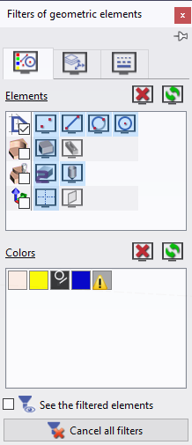



GO2cam V6.10 New Features
10
User Interface
Dialog of Filters
3 tabs instead of 5
Elements & Colors
Layers & Planes
Lines (types and Thickness)
New ability to filter elements by family:
2D
3D
Machining
…
If a 'family' is unchecked: all the elements are visible.
If a 'family' is checked: all the elements are hidden.
a square is displayed If the elements of a family are either hidden or selected.
Notes:
15273:
Molette configurable se trouve dan le software configuration > Units.
Change the increment value ( ex 0.5) and validate.
The increment value changes by 0.5 when scrolling

Slide 7
GO2cam V6.10 New Features
10
User Interface
Display options
Some options are moved from Tools/Options to Display dialog in Status Bar, for a faster access.
- Thicker lines of toolpaths: bolded toolpaths
- Subprogram trace:
If copy of machining cycles are defined, does GO2cam display them or not.
- Tracing Precision:
Display tolerance of solids
Notes:
15273:
Molette configurable se trouve dan le software configuration > Units.
Change the increment value ( ex 0.5) and validate.
The increment value changes by 0.5 when scrolling

Slide 8
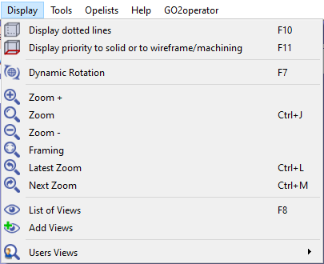
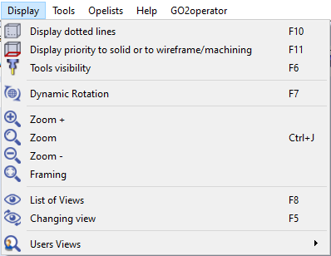
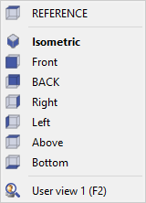
GO2cam V6.10 New Features
11
User Interface
V6.09
V6.10
Display Menu
New access and new shortcut F6 for Tools visibility
Latest and Next Zooms deleted from any menu
New access and new shortcut F5 for Changing view
List of Views change behaviour:
- Add Views is cancelled.
- Default List of Views is more complete
- Current view is bolded
- User views are displayed in the list
Users views are now saved by product (not anymore in the PCE file).
It means that it is linked to the product (Mill Classic, Turnmill Expert, etc.) and that you find them each time you open a new session.
Solution Korea - 14558
Saeilo - 15281
They also appear in the List of views.

Slide 9
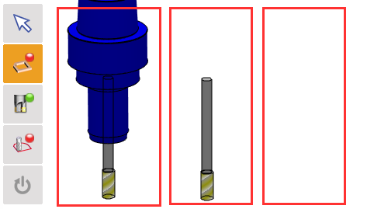
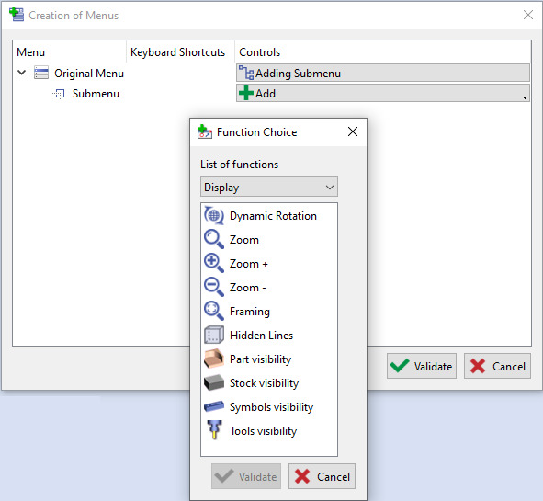
GO2cam V6.10 New Features
11
User Interface
Tools visibility
Hiding tools has now 3 status
Full tool visible
Tool only visible (holder hidden)
Full tool hidden
Warning: this happens only during selection of geometry while defining machining cycles.
Customize menu & Shortcut for Visibility options
Visibilities of Part/Stock/Symbols/Tools are added in the customize menus; there you can add new shortcuts with Ctrl+ …

Slide 10
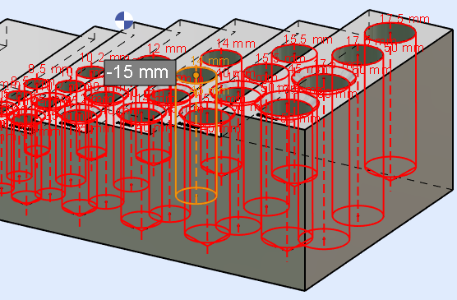
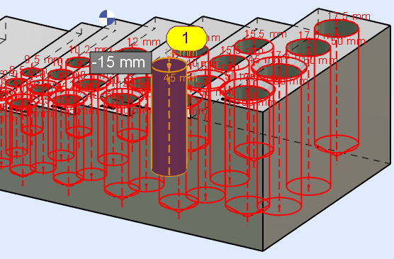
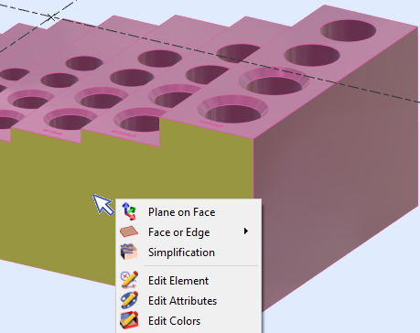
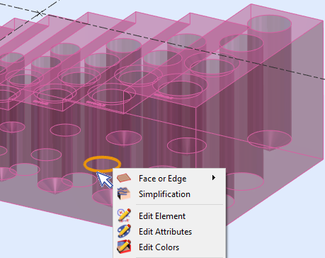
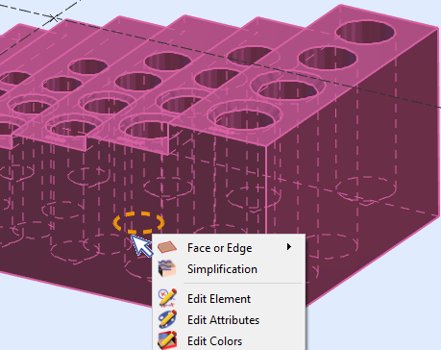
GO2cam V6.10 New Features
13
User Interface
Picking Elements
1. Improved link between highlight and picking : an element which is highlighted is now always selected.
GO2cam Gmbh- 15297
2. Full display, Transparency and hidden edges are taken into account for the picking and selection of elements.
System Technology- 15346
Saeilo - 15498

Slide 11
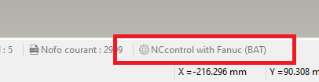
GO2cam V6.10 New Features
User Interface
Checkboxes
GO2cam Gmbh
We Homogenized the position of checkboxes in front of its relative text in all the software
CFX Files
If a CFX file is loaded in GO2cam, the information is now displayed in the System Information Bar.
Printer
We improved the speed while running the Printing and the Print Preview.

Slide 12
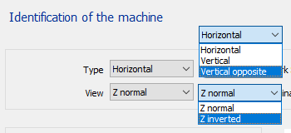
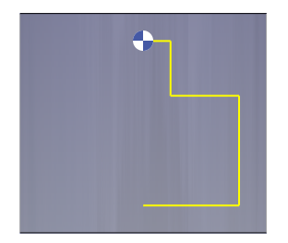
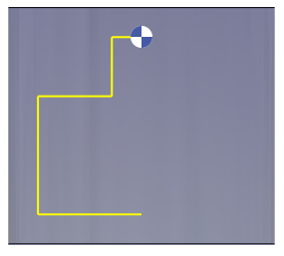
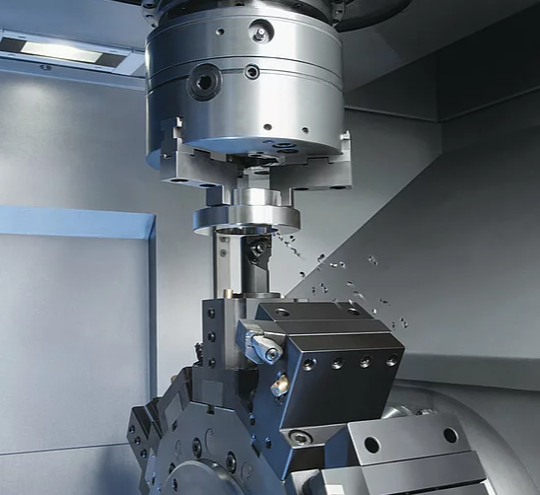
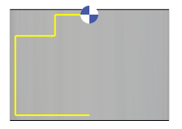
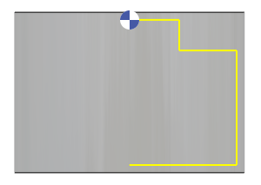
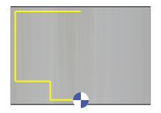
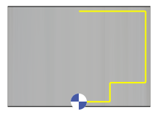
GO2cam V6.10 New Features
User Interface
Machine File: Management of views is renewed for the Turning.
The management of views and sections is now correct:
- vertical standard is inverted compared to V609; we created a new mode Vertical Opposite
- New mode Z inverted
Vertical - Standard
Vertical - Inverted
V6.09
V6.10
Vertical – Z normal
Vertical opposite
– Z normal
Vertical – Z inverted
Vertical opposite
– Z inverted

Slide 13
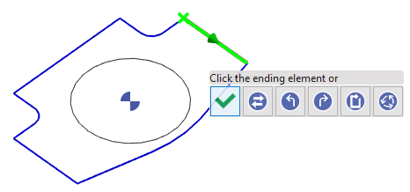
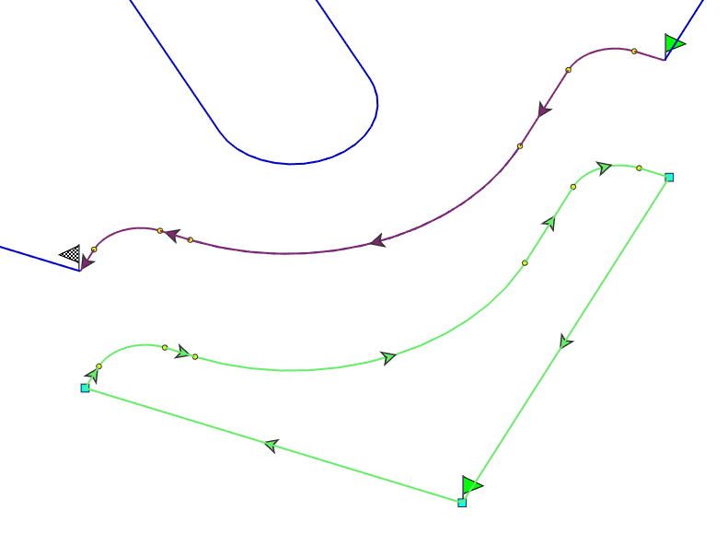
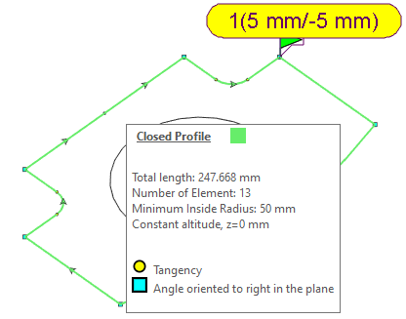
GO2cam V6.10 New Features
12
User Interface / Profiles
Improvement of the Profiles display.
- symbols are 2D instead of 3D.
- The number of arrows is managed according to the Z level.
- The start and end flags are now displayed in machining (not only in design) when Details are ON.
- Convention of symbols and colors kept : yellow round (but smaller) for tangency, green square (left) or blue square (right) for angular corners.
New RapidBox that enables a more rapid access to profile creation options: validate, invert, all on right, all on left, continuous and closed.
New tooltip on profiles, available if the Details function is ON.
This tooltip includes the display caption and several necessary information about the profile.

Slide 14
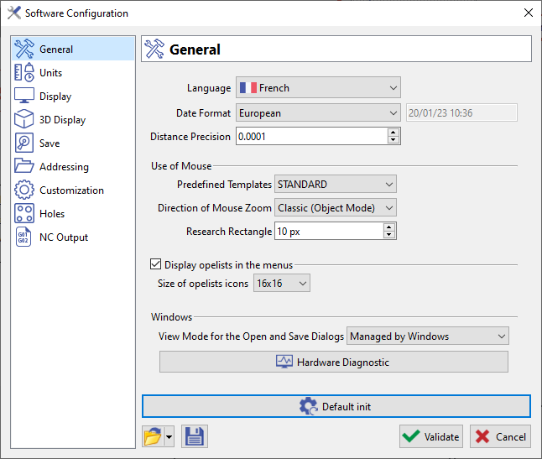
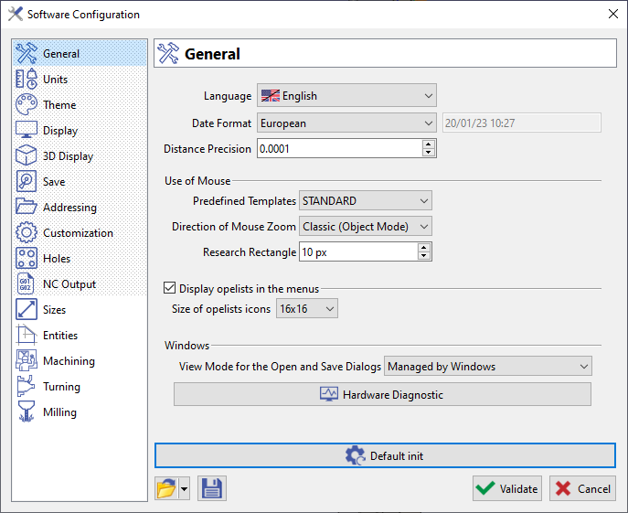

GO2cam V6.10 New Features
14
Software Configuration and Tools-Options
Preferences (Software Configuration) and Options (Tools/Options) are merged.
We still have 2 access, one from Homepage wit the Preferences only, one in the Tools/Options with everything.
The Preferences deal with General options for the software use; the Options are defined by product.
Change of mechanism
- If you do not save your settings, they are kept by product and reload at each new session.
- One unique type of file (*.ini)
(no more OPT / OPG)
- We added a new rapid access to existing files

Slide 15

GO2cam V6.10 New Features
14
Software Configuration and Tools-Options
General Improvements
- New dialog
- Homogenizing and sorting options
No more access to Windows Explorer but direct access by combo
- Spin buttons on all values fields
- Tick button for ON/OFF commands

Slide 16
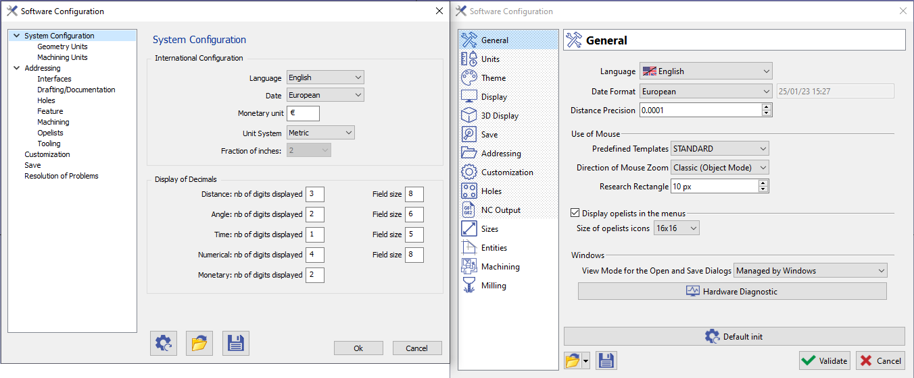
GO2cam V6.10 New Features
18
Software Configuration and Tools-Options
New / enhancement
Options moved
Page General
From Pref / Geom Units
From Pref / Customization
From Pref / Customization
From Pref / Customization
From Pref / Resolution of Pbs

Slide 17
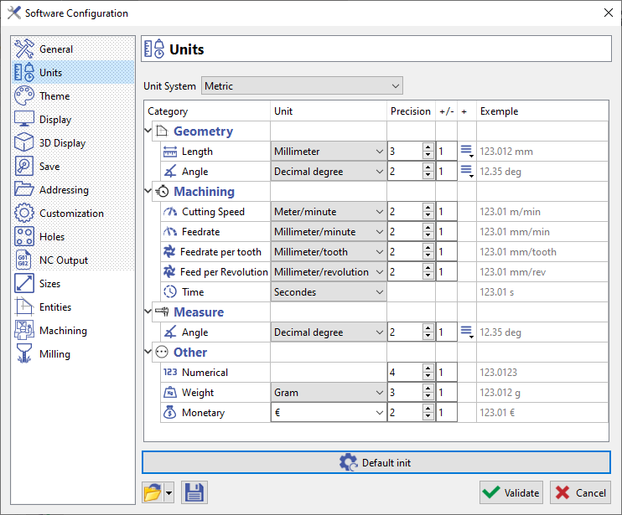
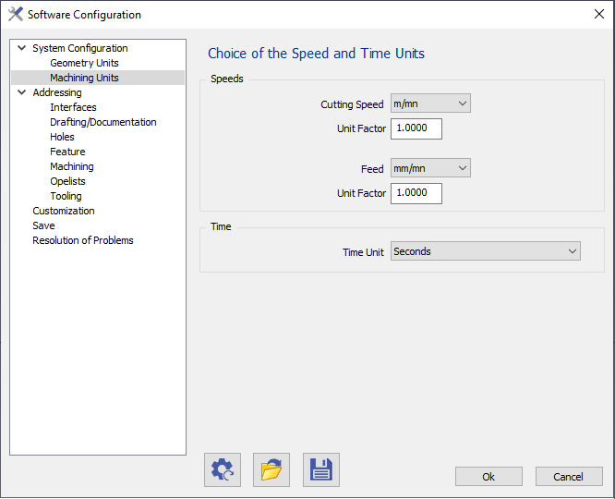
GO2cam V6.10 New Features
New / enhancement
Options moved
16
Software Configuration / Tools-Options
Page Units
Scroll wheel configurable by type of unit
- All units in the software are gathered in the same location.
- Some units are merged: distance, dimensions, measure for example
- Some new units appeared in the configuration, such as:
  Feedrate per tooth
  Feed per Revolution
  Numerical
  Weight
GO2cam France - 15273
Preview
Display type (symbol ° or abbreviation ‘deg’)
From Preferences /
-Syst config
-Geom Units
-machining units

Slide 18
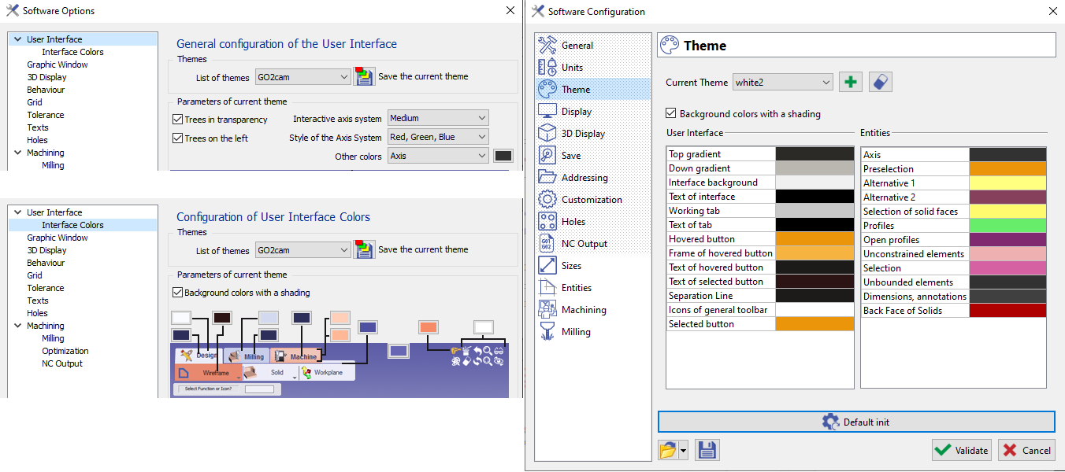
GO2cam V6.10 New Features
18
Software Configuration / Tools-Options
New / enhancement
Options moved
Page Theme
New mechanism of creation and save

Slide 19
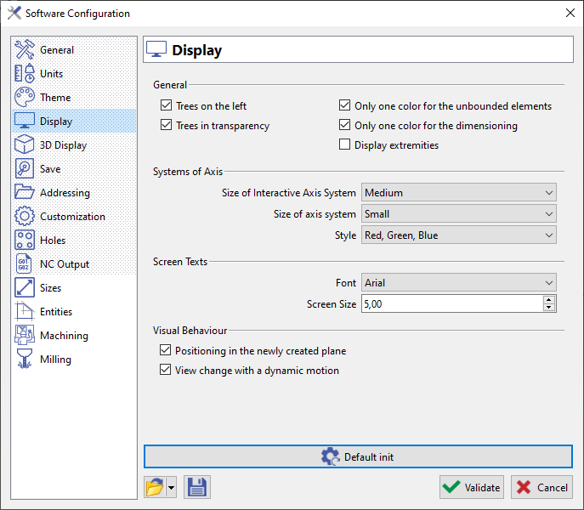
GO2cam V6.10 New Features
18
Software Configuration / Tools-Options
New / enhancement
Options moved
Page Display
From Options/ User Interface
From Options/ Graphic Window
From Options/ Texts
From Options/ Behaviour

Slide 20
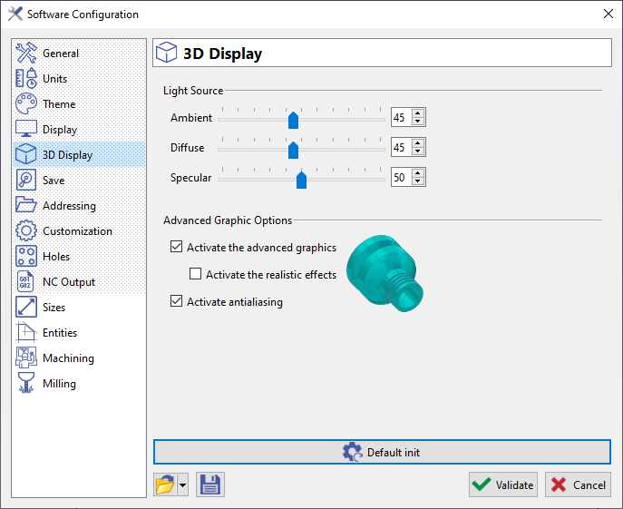
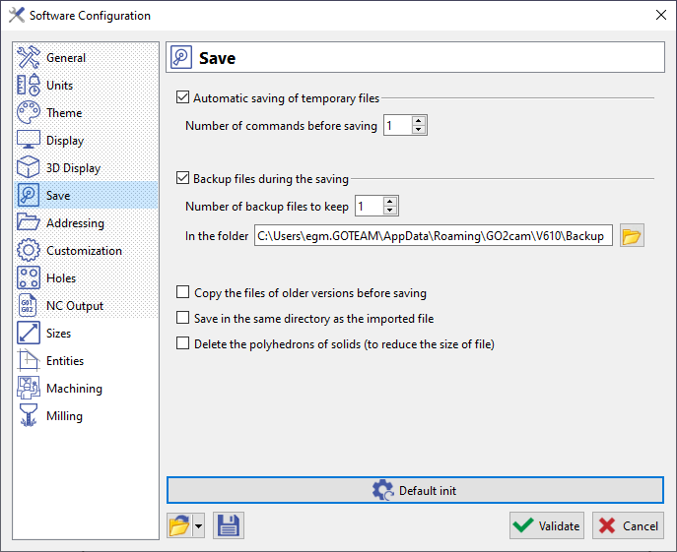
New / enhancement
Options moved
GO2cam V6.10 New Features
Software Configuration / Tools-Options
New mechanism: tick box instead of 0
Page 3D Display
Page Save
From Options/ 3D Display

Slide 21
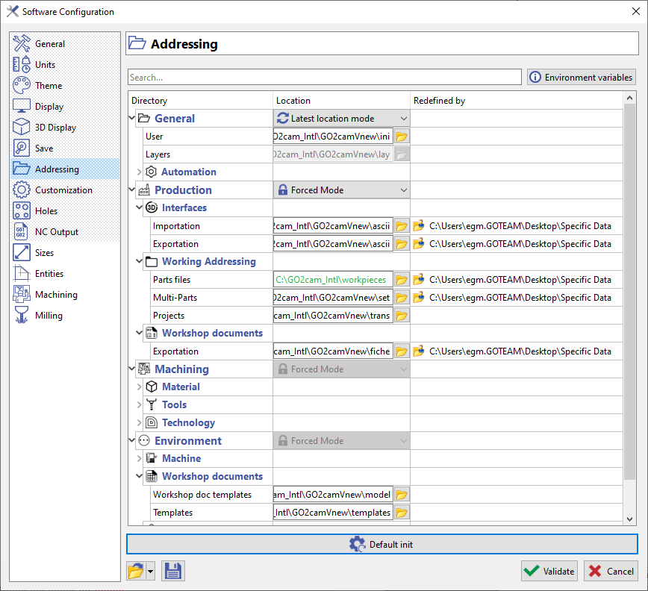
GO2cam V6.10 New Features
15
Software Configuration / Tools-Options
Jinfo - 15366
Abba
Addressing
Page Addressing
Many improvements in a brand new page:
- 1 unique page more compact and simple; you can open or hide branches of the tree.
- The page only shows the addressing that the user can modify; not anymore the system directories.
- Addressings are sorted in 4 main categories:
  General (user and automation)
  Production (project/doc creation)
  Machining (tools, mat, tec, etc.)
  Environment (mac, sym, etc.)
- New mechanism to deal with the 2 main users methods:
Forced: use of a fixed directory, which is displayed in green in the table.
Latest Location: always keep the last directory used
Always in Forced mode
Warning: in forced mode, if a PCE file was open from another directory than the forced one, we save it later in the directory where it comes from, to avoid to duplicate the PCE file.

Slide 22
GO2cam V6.10 New Features
15
Software Configuration / Tools-Options
Jinfo - 15366
Abba
Addressing
Some other special cases are taken into account:
  - read project files (GMZ, GPZ) that change addressings,
  - use Machine files (MCF, MCT, MCE) with specific directory,
  - define special 'Working Directory’.
In those 3 cases, the addressing is considered as temporary, and we write it on the third column of the table, which is called 'Redefined by'.
The *.CFX files are also managed. If they include keys DIRECTORY, such as <DIRECTORY key="ZZTOOL" name="v:\new\bin\tool"/> the location is forced and set to green.
→ The table always keeps you informed about the addressings, even temporary ones.

Slide 23
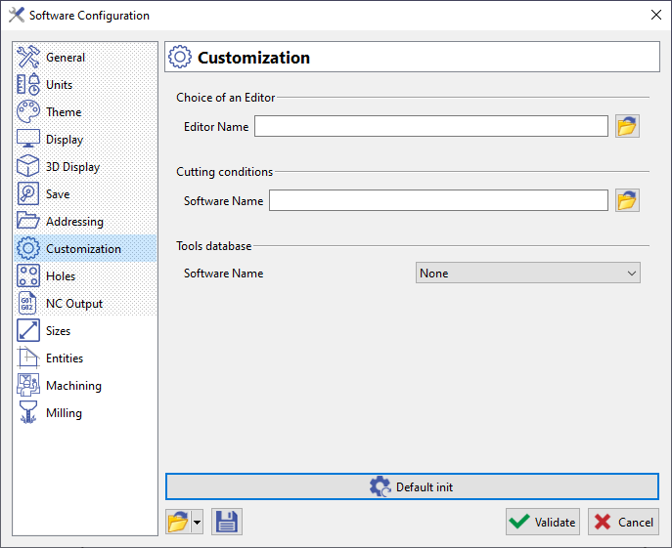
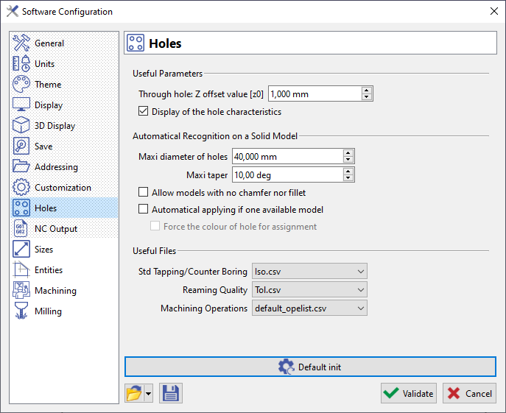
New / enhancement
Options moved
GO2cam V6.10 New Features
Software Configuration / Tools-Options
Page Customization
Page Holes

Slide 24
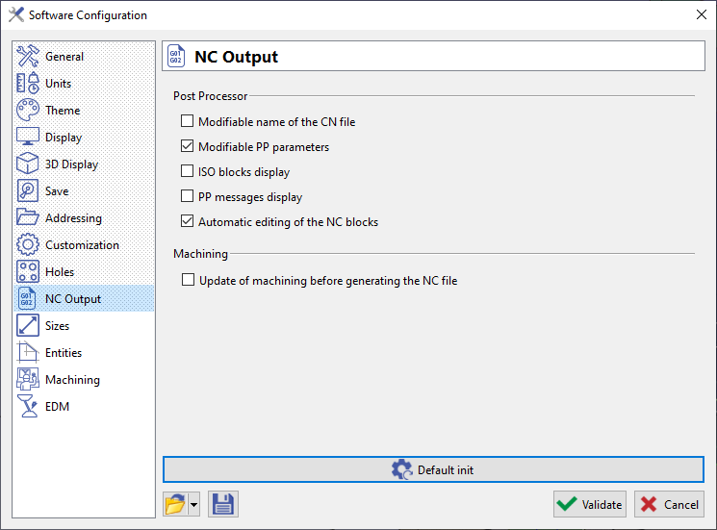
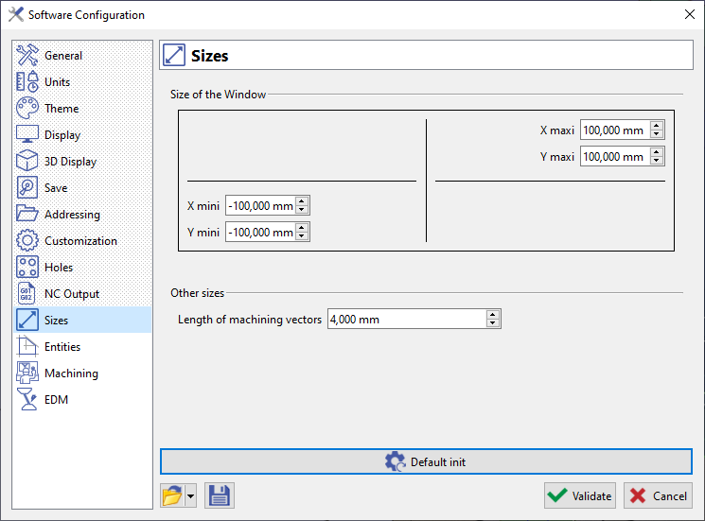
New / enhancement
Options moved
GO2cam V6.10 New Features
Software Configuration / Tools-Options
Same content except 2 options that moved to Machining
Page NC Output
Page Sizes
New Page
From Options/ Graphic Window

Slide 25
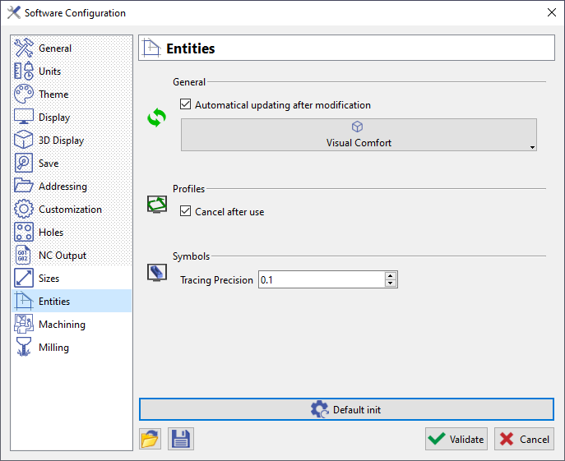
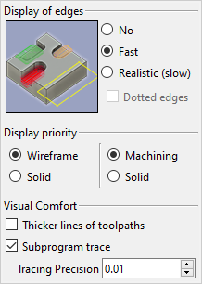
New / enhancement
Options moved
GO2cam V6.10 New Features
Software Configuration / Tools-Options
Page Entities
New Page
6.09.202
We added the display options also accessible in the status bar.
It enables to save those settings into a *.ini file.
From Options/ Behaviour
From Options/ Tolerance

Slide 26
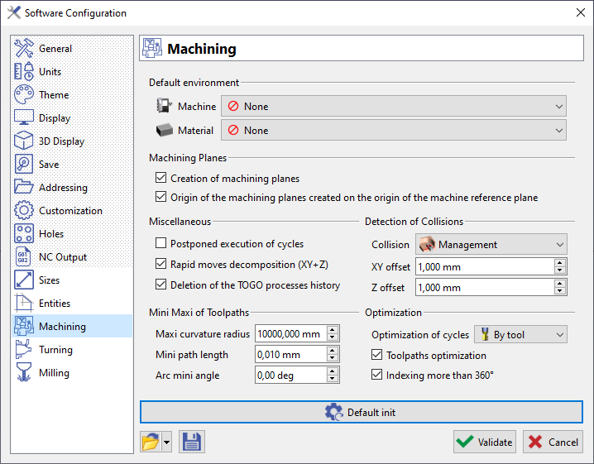
New / enhancement
Options moved
GO2cam V6.10 New Features
Software Configuration / Tools-Options
Page Machining
From Options/ NC Output
From Options/ Milling
From Options/ Optimization

Slide 27
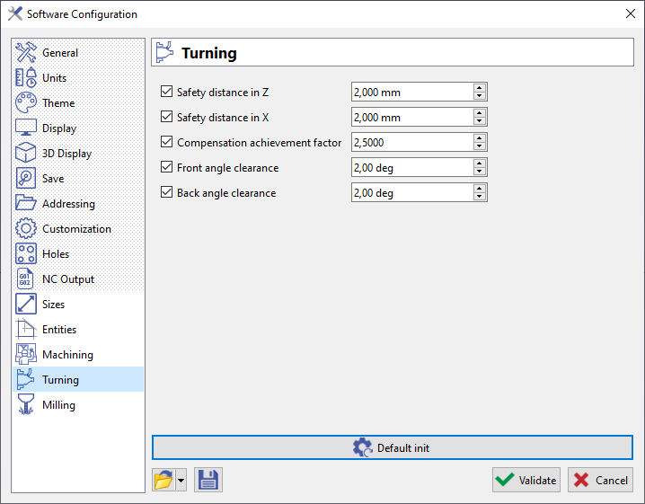
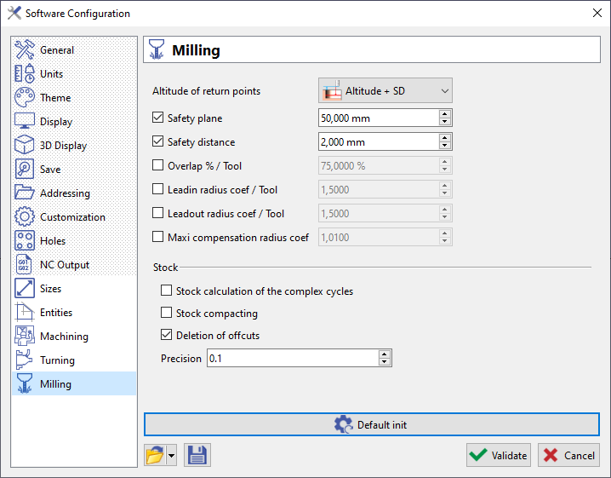
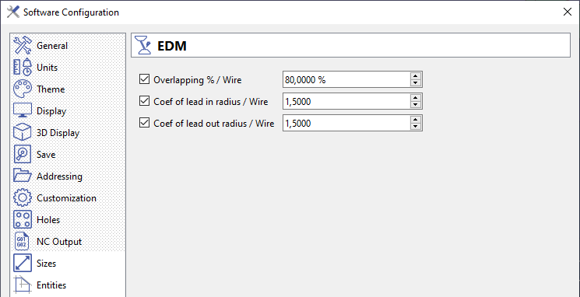
New / enhancement
Options moved
GO2cam V6.10 New Features
Software Configuration / Tools-Options
Pages Milling, Turning, EDM
Same content

Slide 28
GO2cam V6.10 New Features
16
Units
17
Management of units
We can now work in inch and choose tools/technos in millimeters. Reverse option is also possible.
Also, in the tools and technos libraries, we added the choice of unit (metric or imperial) to manage the case of working with a unit different thant the current one.
Working in mm with tools in inch for instance!

Slide 29
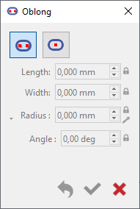
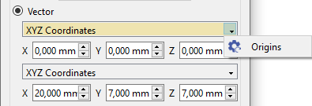
GO2cam V6.10 New Features
20
Design
Workflow: the access to commands is contextual.
If a command is not supposed to be used, it is greyed out.
Ex: if there is no wireframe geometry on the screen
→ no ‘Drawing’ and ‘Trace Profile’ available!
Oblong
new mode of creation by center
Saeilo - 15219
Move
Duplicate
- When an axis has to be selected for the motion, you have now a combo box with the list of axis, X, Y and Z.
- When a translation is defined by vector, you can reset the values to origin: the access is not anymore by right-click but with a popup
Saeilo - 15500

Slide 30
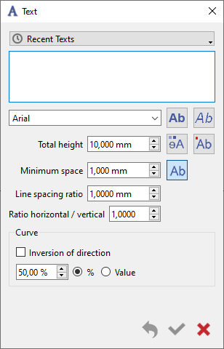
GO2cam V6.10 New Features
20
Design
Text
Several improvements:
Ability to keep a list of texts previously used
System Technology - 15392
New option to make texts filled or stroke
GO2cam France - 15317
New ratio to manage width and height of texts
GO2cam France - 15382

Slide 31
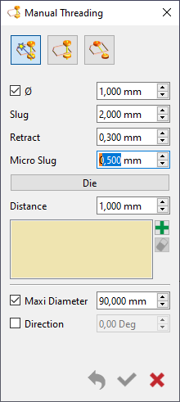
GO2cam V6.10 New Features
Wire EDM Geometry
Threading Points
21
Gear
Toothing
New Reset button to clear all the values to default ones.
One only command (automatic, manual, inclined).
New dialog similar to design commands
Preview of result
GO2cam France - 15415
- New ability to set the slug value to 0.
Can be useful in some cases for 4 axis machining
- New parameter ‘Maxi diameter’: used in case of machining of circle.
Below the value, the threading point is on the center of circle, either it is closer to the profile by the ‘distance’ value

Slide 32
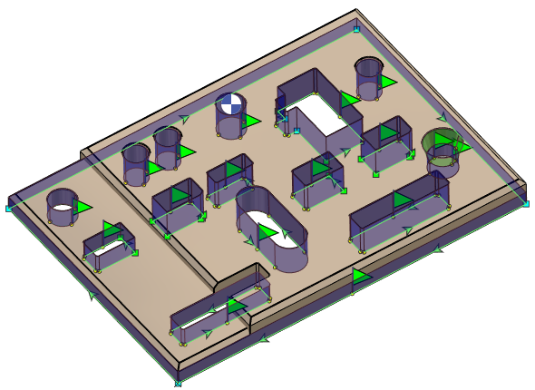
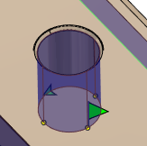
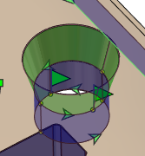
GO2cam V6.10 New Features
VM
91
Wire EDM Geometry
Recognition of Profiles
- Better solid analysis if there are several horizontal faces with different Z
- New option: maxi taper angle to avoid chamfers but still recognize collets

Slide 33




GO2cam V6.10 New Features
VM
Solid Design
Main Improvements
GO2cam France - 15224
User Interface:
New menus and organization of commands
Merge of commands (from 43 to 34 commands)
Display help: Preview + convention of colors
direct access by right-click on faces
Union: green / Subtraction: red / Intersection: blue

Slide 34



GO2cam V6.10 New Features
VM
Solid Design
Main Improvements
GO2cam France - 14214
Workflow:
commands of creation and boolean operations set together
If there are several solids, you can choose the one you want in a combo box.
Commands are greyed out or invisible (dialogue) if not possible.
Examples:
no Extrusion or Revolution possible if there is no wireframe geometry on screen.
No boolean operations if only one solid

Slide 35


GO2cam V6.10 New Features
VM
Solid Design
Main Improvements
New modes of construction:
type of construction: cylinder based on circle, block based on rectangle etc.
contextual creations with cursor (ex: depth of cylinder by clicking solid edge)
Homogenization with wireframe
Example with a cylinder tangent to 2 lines and parametric design
Grid
New grid available while working in Z direction

Slide 36


GO2cam V6.10 New Features
VM
Solid Design
New Features
3 New Features, all available by popup menu
Creation of plane on a face
Click directly a face to create its corresponding workplane
Clone the Face
14201
Creation of a new independant face, by cloning an existing one
Redefine the UV
If UV are badly defined in a solid, we can modify them by choosing the correct axis (X, Y, Z) and recalculate the isoparametric toolpath.

Slide 37



GO2cam V6.10 New Features
Solid Design
New Features
Calculation of Surfaces in mm2
Entity Information
GO2cam France - 14790
Saeilo - 15289
- In solid Information, the whole solid surface is given.
- The surface of the clicked face is also displayed.
This surface is also given with the Control
Saeilo - 15294

Slide 38





GO2cam V6.10 New Features
Solid Design
New Organization of Commands
Creation:
V6.09
V6.10
Modifications & Adv Modif:
Modifications & Faces
V6.09
V6.10
Merge in Boolean Ope
Merge in Extrusion
Merge in Extrusion
Move to Faces
Move to Faces
Deleted

Slide 39




GO2cam V6.10 New Features
Solid Design
New Organization of Commands
Operations on solids
Wireframe
Holes on solids
Features
V6.09
V6.10
V6.09
V6.10
Move to Faces
New commands / Features
(see corresponding slide)
Only once, in Features
Holes Recognition

Slide 40

GO2cam V6.10 New Features
VM
Solid Design
New Features in the Commands
Extrusion
HDMI - 11005
  Extrusion on any axis
  Extrusion on segment or circle or any set of elements with thickness
Here we selected a single segment (in yellow). We extrude it of 25mm and give a thickness of 10mm on the left side. It creates a kind of 3D slot that we can subtract from main solid! Here you can see the preview in red.
Taper angle can be negative (deletion of one option ‘outside’)

Slide 41


GO2cam V6.10 New Features
Solid Design
New Features in the Commands
  Revolution
New dialog similar to other commands / Preview of result
Surfacic revolution is merged into Revolution
A negative angle changes the direction of rotation. Invert enables to change the direction of + and -
No need anymore to change the direction of rotation by right-click…
Complete revolution is cancelled; 360° is the default value when you enter the command.
V6.09
V6.10

Slide 42
GO2cam V6.10 New Features
Solid Design
New Features in the Commands
  Extrude along path
New dialog similar to other commands / Preview of result
New: Surfacic creation on a closed profile is now possible
New: ability to do multiple selection at once
  Lofting
Same as V609 except the change of one icon and the buttons Validate-Cancel
If the creation is not possible, the selection of profiles and guides is not erased as in V609!

Slide 43

GO2cam V6.10 New Features
Solid Design
New Features in the Commands
  Bounding Box
New dialog similar to other commands / Preview of result
New: information regarding the size of new element is given
  Rectangular Cuboid
New dialog similar to other commands / Preview of result
New modes of construction by 2 points, 3 points and Center

Slide 44

GO2cam V6.10 New Features
Solid Design
New Features in the Commands
Cylinder
Sphere
Cone
Torus
New dialog similar to other commands / Preview of result
New modes of construction by Center+radius, 2 points, 3 points, predefined
New: ability to define diameter instead of radius
VM
Boolean operations
Merge of 4 commands: union, subtraction, limitation and multi union
New dialog similar to other commands / Preview of result
New: multi-selection not only on union but also subtraction and intersection.
New: ability to keep the element subtracted

Slide 45



GO2cam V6.10 New Features
Solid Design
New Features in the Commands
Chamfer
Fillet
Fillet with Variable Radius
New dialog similar to other commands / Preview of result
Same characteristics than V6.09
New dialog similar to other commands / Preview of result
New process of creation:
  you can click edges but also faces
  you can select middle of elements directly (no more Ctrl+Shift shortcut)
  the elements selected are also shown on screen by a balloons; a tooltip can show you the radius value.
  The list of points and radii is given in the dialog; a right-click enables to delete a point.

Slide 46

GO2cam V6.10 New Features
Solid Design
New Features in the Commands
Shell
New dialog similar to other commands / Preview of result not automatic (button)
Same characteristics than V6.09
  Taper:
  Reference direction can be defined by an existing plane (not only a face)
  New concept of Pivot point

Slide 47
GO2cam V6.10 New Features
Solid Design
New Features in the Commands
Face Offset
New dialog similar to other commands / Preview of result
Same characteristics than V6.09
Solid Section
New dialog similar to other commands / Preview of result
Ability to select any plane as Cut plane (no need to create a Wplane as before). You can click a solid face for instance.
Same characteristics than V6.09; we can keep both sides of the solid (appeared during 6.09)

Slide 48



GO2cam V6.10 New Features
VM
Solid Design
Editing
Many improvements
- Editing a solid is contextual: wherever you double-click on the solid (or right-click to open popup menu), it opens a different line in the editing tree.
- Editing an element opens back the dialog used to create it
- Construction points are visible: a color convention is applied to free points (green), locked points (red), selected point (highlighted)
- New ability to edit values directly in the dimensions
- Constraints can be changed afterwards:
  Tangency modified into perpendicularity or other!
  Change of reference element!
- the elements created before are also shown.

Slide 49


GO2cam V6.10 New Features
Management of Solids
Assignment of Solids
10
VM
22
Back of solid Faces Colors
We have added a color for the opposite side of the solid faces. This is available in the themes of Tools/Options.
Consequently, if faces are missing, we see the ‘inside’ of the solid, with this color.
Example below with the color of Back faces set to Red:
This new command enables to access to the table of assignment of solids, where you decide whether a solid is the workpiece, the stock, a clamping element or something else. This table is usually accessible while importing a solid or set of solids.
This command, located in the menu File/Add can be useful:
- if you canceled the automatic import and want to be back to the assignment step
- If you design the workpiece, and design or add the stock (in solid) and other elements such as clamps (still in solid), once all on the screen you can call the table to assign their typology to each of them

Slide 50

GO2cam V6.10 New Features
Nesting
Import
Ability to import any type of solid CAD format files (only X_T in V609)
CAD Import
Automatic Solid Import
DataGO / GO2SW
35
Update of the dialog: we now display the list of added faces. Very useful in the case of Spaceclaim that has non-constant ‘persistendId’.
When you import solids with automatic import and want to define a cylindric stock: you can define its position with this new option to be at center of a cylinder instead of barycenter of part.
GO2cam France - 15107

Slide 51


GO2cam V6.10 New Features
Layout Design
Import image
Convert image in polyhedron
- Import image is now possible by drag & drop
- Convert image in polyhedron is renew with options in a dialog.
- Import image is renew with options in a dialog.
- We added the preview of resulting polyhedron.
- Background Picture is now the same as Import image

Slide 52



GO2cam V6.10 New Features
Layout Design
Hatching
Layout of Solid
Command renewed with a dialog
Hatching is renew with options in a dialog. Same options except ‘Vectorial’ are reproduced.
V6.09
V6.10
New type of object

Slide 53



GO2cam V6.10 New Features
41
Tooling
GO2cam Gmbh - 13387
Barrel mill cutter
New parameter Definition of Profile, that enables to create 2 types of shapes; one on the middle (as previously), one on the top of shape.

Slide 54


GO2cam V6.10 New Features
41
Tooling
Milling Tools
The maxi rotation speed (RPMX) is added to the whole list of milling tools.
Face Mill Cutter
GO2cam Shanghai - 14948
Tool definition was not correct according to Standards.
We switched from Mini and Cut diameters (Dm and DC) to Cut and Maxi diameters (DC and DCX).
Useful for the cutting conditions calculation
V6.09
V6.10

Slide 55

GO2cam V6.10 New Features
Tooling
Square Shoulder Face Mill
We added the Clearance options to create different profiles of square shoulder face mill cutters
GO2cam France - 15532
GO2cam Gmbh - 15531

Slide 56

GO2cam V6.10 New Features
42
Tooling
GO2cam France - 15395
Thread Mill Cutter
New ability to define a range of pitches in the tool page. Some of those tools can realize threads with pitches from 0,5 to 2,0 mm for instance.
Mechanism for calculation:
Set the range of pitches to Yes,
Maxi pitch option is activated. Pitch value corresponds to ‘Mini pitch’
The cutting length is automatically forced to the value of mini pitch,
Number of flutes is automatically forced to 1.
→ In the strategy page of Threading, the pitch field becomes activated. You can enter a value contained in the range of pitches of the tool page, if not you get an error message .

Slide 57

GO2cam V6.10 New Features
VM
Milling Features
New Optional module that enables to generate automatic features from the topology analysis of a solid.
In the menu Solid, the submenu Holes is now called Features.
- The features are based on multiple calculation:
    - stock based: Facing and Silhouette Milling
    - solid based: Pockets and Slots
    - HMF for holes calculation
    - wireframe for deburring.
- Those features are linked to predefined opelists.
- The tools are searched into libraries thanks to opelists formula and constraints
- New link with the cutting conditions that are automatically applied according to the material and the definition of cutting conditions by tool. Also, we added the new possibility to define Ap/Ae values for each tool and apply them directly in the machining of features!

Slide 58
GO2cam V6.10 New Features
Cutting Conditions
Many major improvements in the definition and management of Cutting Conditions
1- The table to create cutting conditions files has been renewed
2- New method of creation of CSV files
3- New management of tools with 2 types of calculation:
    - Generic tools (by ranges of values)
    - Manufacturer tools (catalog recommendations): ability to define cutting conditions for each tool of library.
4- Ability to choose the unit of the cutting conditions files (metric or inch)
5- Ap/Ae (Z step, lateral step) consideration added in the cutting conditions
6- In the Technology page of cycles, the access to Cutting conditions has been improved.
7- Update Cutting Conditions

Slide 59


GO2cam V6.10 New Features
Cutting Conditions / Creation
1- Tables renewed: more modern and homogenized with other dialogs of software.
6.09.202
New ability to create cutting conditions files (*.CSV) from scratch. Previously, you could not enter the cutting conditions table without loading a file ; now, if there is no loaded file we display a new icon. Simply give a name, click the ‘+’ icon and a new file is automatically created.
6.09.202
Also, when creating this new file, you are asked if the file will be in metric or inch unit.

Slide 60



GO2cam V6.10 New Features
30
Cutting Conditions / Creation
1- Tables renewed: more modern and homogenized with other dialogs of software.
2- New: 2 types of management of tools
Cutting Conditions can be defined per each tool.
A same tool can be defined several times because you choose the type of application for the tool: contouring, pocket, millyuGO, etc.
Management as in V609.
Tools are sorted by range of values. Cutting Conditions are defined for each range of values.

Slide 61

GO2cam V6.10 New Features
30
Cutting Conditions / Creation
New process for creation with 2 pages instead of 1
1st page: tables of ranges or tables of tools. New: values can be modified directly in the table fields
Edit the selected line
You can also edit a line by double-cliking it!
Create a new entry in the table
Delete

Slide 62


GO2cam V6.10 New Features
30
Cutting Conditions / Creation
New process for creation with 2 pages instead of 1
2nd page: editing the selected line enables to define cutting conditions for each tool or each range of tools
New types:
- millyuGO
- Axial is defined for Flat End Mill used for drilling operation.
System Technology - 14457
- Cancel or
- Validate and Back to the table

Slide 63





GO2cam V6.10 New Features
30
Cutting Conditions / Creation
Input of Values
You can enter values with the keyboard of course but you can also copy some values and apply them on other lines. Right-click on the selected lines to get options for that.
Choice of Units
A right-click on the column head enables to switch from Cutting Speed to Spindle Speed. Same for the calculation of feedrates.
Back to the table of tools after changing a speed unit, you may find range of tools or single tools with different units than the rest of the table. In that case, they are displayed in a blue colour, so that we can easily see that the units are not the same as the majority.

Slide 64

GO2cam V6.10 New Features
30
Cutting Conditions / Creation
When you want to define cutting conditions for one specific tool, you click on add
The following table is opened:
You accede to the complete list of tools libraries:
Tool: tools created and used by the customer
Standard: tools installed by GO2cam
Any folder from GO2Tools (download)
Choose a tool and click Open.
A same tool can be defined several times because you can choose the type of application for the tool: contouring, pocket, millyuGO, etc. The type 'Axial' is defined for Flat End Mill used for drilling operation.

Slide 65

GO2cam V6.10 New Features
31
VM
Cutting Conditions / Calculation
Milling Features
4- Management of Ap / Ae by the cutting conditions
The technological parameters Ap (Z step) and Ae (Lateral step) can be defined for each quality (roughing, ½ finish, etc.).
When the material file is loaded and the tool chosen, the Ap/Ae values are taken and applied from the cutting conditions!
This is only possible if you manage tools with the mode ‘Manufacturer tools’
Consequently, we also modified the process for cutting conditions calculation. You can choose:
Without calculation
Cutting Conditions Only (no Ap/Ae)
Cutting Conditions Full
Access to management of cutting conditions:
- List of Operations
- Techno pages (for cycles and opelists)

Slide 66


GO2cam V6.10 New Features
31
Cutting Conditions / Calculation
5- Techno page: dialog for cutting conditions is renewed
- Access to management and quality of cutting conditions, that can be changed.
- The tool, material and cycles names are given (not changeable)
- On the right side are shown the cutting conditions.
- You can unlock them and modify them. You can even save them directly into the *.csv file!
6- Cutting Conditions Calculation:
If the new calculation modifies the Ap and Ae values, we display the modified values into the information box.
Also, the update command is highlighted with the orange balloon.

Slide 67

GO2cam V6.10 New Features
32
Machining Generalities
Machine File
Saeilo
2 improvements for the machine file:
- Add of Rename in the popup of Machining Tree
- If you do ‘Save as…’, and if there are some files linked with the same name, then those files will also be copied under the new given name (image, XML ...).
GO2cam France - 14919
Machining Tree
When a cycle is programmed and have the same name as a cycle already calculated, GO2cam gives an index number to identify the cycles.
Strategy Pages
GO2cam Gmbh - 15090
Units can be visualized in all the fields of strategy pages.
Conversion from a unit to another is also available: if mm is the current unit, you can type in '1.24 m' and the field will display 1240 mm. Same to convert inches to mm and reverse.

Slide 68

GO2cam V6.10 New Features
Machining Generalities
List of Operations
Saeilo - 15424
Camn’GO - 15129
32
GO2cam France - 15299
‘Tool Orientation’ and ‘Part Rot’ are added in the List of Machining ‘Mach Plane’
Customize List of Operations
We added Z allowance and XY allowance for turning operations
Update
System Technology - 15016
If the status to update is orange and that you save the file, the update is now saved and kept in the PCE file.

Slide 69


GO2cam V6.10 New Features
Machining Generalities
Lists of Cycles
Developed plane
GO2cam France - 15432
New ability to archive some cycles in the list of cycles, used in:
the Standard cycles
The 5 axis Expert cycle
32
We improved the time calculation when machining into a developed plane defined in degrees.

Slide 70
GO2cam V6.10 New Features
Simulation
Dynamic Simulation
Dynamic Simulation
33
When we run the simulation, there is a systematic control and we apply sewing treatment to the solid.
Camn’GO - 14976
New option to pause the simulation if we switch from an operation to the next one ('Pause if cycle change')
GO2cam Gmbh
Toolpath Simulation
We can now edit any cycle while running the simulation, simply by double-clicking it in the machining Tree.
The simulation Pacman does not exist anymore
GO2cam Gmbh - 15373
Tapping operation: we can now simulate the tapping steps while setting OFF the ‘Simplified Machining’.

Slide 71


GO2cam V6.10 New Features
Machining Generalities
Probing
System Technology - 15477
New parameters to define a range of Measure tolerances for the probing cycle (Part Control)
GO2cam France - 15450
Opelist
We added the parameter NCstd in the configuration of Opelists

Slide 72

GO2cam V6.10 New Features
41
Milling / Pocket
Saeilo - 15043
Tool Finder
When the selection of geometry is already done, the tool finder enables to preselect a tool by analyzing the corner radii and passageways of the selected pocket(s).
The tool finder can now be disabled by checking a new button in the library of tools.
The chosen status (ON or OFF) will be saved and kept between 2 sessions of GO2cam.

Slide 73



GO2cam V6.10 New Features
54
Milling / Manual Cycles
Automatic control of the side of machining
We have added a new control of the side of machining, for manual cycles programmed on solids.
If a the direction of profile and the direction of toolpath do not fit according to the shape of solid, GO2cam automatically inverts the profile direction!
→ WARNING: not available with 2D profiles! (including edges!)
In the case below, the profile is counterclockwise and the tool is programmed on the left side of solid: GO2cam automatically inverts the profile direction to avoid machining inside the workpiece!

Slide 74



GO2cam V6.10 New Features
52
Milling / Contouring
GO2cam France - 14897
Contouring with Lateral passes: setting the parameter Retract Altitude to the option ‘Without retract’ is now taken into account.
GO2cam France
Contouring: setting the parameter Retract Altitude to the option ‘Alt+SD’ now generates Rapid plunges (G00 instead of G01 previously).
The retracts were already done in rapid motions.

Slide 75


GO2cam V6.10 New Features
Milling / Chamfering
GO2cam France - 15381
52
Calculation in Corners
GO2cam France - 15431
Leadin/leadout Settings
When a profile selected is ‘without chamfer’, we now apply a new calculation, directly based on the bottom profile, for the XY passes. This new calculation generates better toolpath in corners, with less risks of collision.
When a collision is detected, the toolpaths is reduced to avoid it. Previously the leadin/leadout settings were cancelled in that case;
from V6.10, we now keep the setting for the opposite side of the collision.
V6.09
V6.10
Automatic Deburring
When selecting sharp edges to program deburring of a complete workpiece, there is a new ability to avoid small motions, by giving minimum length of toolpath desired.
Page: Options / Parameter: Mini profile length

Slide 76


GO2cam V6.10 New Features
51
Milling / Drilling
CAM-Team - 14612
Ability to define a special feedrate for the first drilling depth of the cycle.
In a case of an inclined hole, we must start with a reduced feedrate and increase the feedrate as soon as the drill is correclty engaged.
For this, the new option Leadin Depth is added in Strategy and Leadin Feedrate is added in Technology.
GO2cam France - 14907
New Deburring distance to retract further and facilitate the retract of chip and the coolant fluid.
System Technology - 15306
Polar Optimization
When optimizing the toolpath by polar mode, we added the ability to choose the starting point of optimization.

Slide 77

GO2cam V6.10 New Features
Milling
53
Interpolation
Thread Milling
AM Engineering - 15062
52
GO2cam Gmbh - 14408
Already in V6.09
New ability to program Outside Thread milling operations!
The leadin helix now starts higher of a ½ helix, so that the tool enters the material with helix motion.
(available if: no predrill + continuous toolpath)
Previously, it was possible to program an outside thread with a contouring, but then, it was impossible to have evolutive leadin arc to enter the material. With this new option, it is possible and it avoids leaving a mark in the face.
3X Deburring
Preview of the calculated edges

Slide 78

GO2cam V6.10 New Features
60
MPM
Solution Korea - 14849
Management of Program Origins
Camn’GO
The purpose is to define Program Origins that are different from the system of axis on which is set the part. For instance, in the case of a tombstone, we would like only one origin on top of element.
1. For this, we added a new option, in the creation of symbol. When you define a system of axis, you can choose to link this system of axis to a specific origin: it can be one by setting, par support face, etc.
By the way, several systems of axis can have the same origin.
Then, in MPM, in the Assignment of origins, you need to choose the mode ‘Systems of Axis Origins’ and then the origin is not the one of the system of axis but the ‘linked’ one.

Slide 79

GO2cam V6.10 New Features
60
MPM
Solution Korea - 14849
Management of Program Origins
Camn’GO
2. We also added a new mode of origins management 'Clamping Elements Origins ' that enables to recover the origin of system of axis 0 of Work-holding device.
We have now 4 modes of selection that have been renamed:
  1- REFERENCE Origin (Auto Machine): 1 reference plane origin
  2- Clamping Elements Origins: 1 origin from Tombstone System of Axis 0 (or several if other clamping systems)
  3- Systems of Axis Origins (Auto supports): several origins defined on the systems of axis. Example: origins defined on each face of tombstone.
  4- Parts Origins (Auto Parts): 1 origin by part
3. When a name is given to the origin or modified, if other systems of axis have the same origin, the name is also automatically given to all the systems of axis.

Slide 80

GO2cam V6.10 New Features
70
Turning
Setting Stock / Chuck
New calculation of the position of stock in the chuck, especially useful for Bar Turning
We calculate a distance between chuck nose and the end of part.
For this, some values are recovered in the part and others are calculated:
- We read the parting cycle to recover tool width(TW) and allowance (PA).
- We analyze stock and part to get the lengths (PL) and Facing allowance (FA).
- We also added a safety distance (S) if the user wants to move the position.
All those information are displayed in the dialog and we calculate the result.
There is also a treatment of mistakes:
- We display information to understand why the result is incorrect
- The parting values are greyed out if the cycle does exist.
When we validate the dialog, the value is automatically written in the dialog area.
This value can be considered as the minimum position necessary to machine correctly the part.

Slide 81
GO2cam V6.10 New Features
72
Turning
Pilot Points vs Cursor
The tool cursor is now locked to its real pilot point.
If we work in ‘Imaginary Nose’., the chosen point is the one we have on the tool.
This is available for all the turning cycles.

Slide 82

GO2cam V6.10 New Features
72
Turning / Toolpath
Roughing and Finishing operations
HDMI - 14993
We have added a new type of toolpath calculation: Part (Imaginary nose)
The toolpath is calculated on the part and we can manage correctly the rapid motions of cycle (take and lose of correction) and inter-cycles because we know how the tool is piloted.
Former option Part is now called Part (Tool center)
This option enables to fix an issue in the inter-cycle rapid motion for:
Roughing and finishing operations programmed with the same tool
Roughing toolpath in Imaginary Nose, Finishing in Part
In this situation, we also advise to force the P Point option directly in the tool page, so that you cannot have 2 different piloted points for the same tool!

Slide 83

GO2cam V6.10 New Features
Turning / Toolpath
turnyuGO
Roughing
CAM-Team - 15240
71
We improved the chip-breaking when ‘Retraction’ is set to ‘Profile’. Previously, the last pass that follows the profile was not considered by chip-breaking: it is done in V6.10 but a dwell is applied, not a retract.
We added a new management of return to prevent from collisions while retracting from grooves and undercut areas. A leadout distance can be defined.
This type of return has 3 modes:
none: the leadout is not applied
Partial: the return is applied only while going out of undercut areas
Total: the return is applied in all the cases.
Parallel Roughing
GO2cam France - 15149
The chip-breaking options are added to this cycle.

Slide 84



GO2cam V6.10 New Features
73
Turning / Toolpath
GO2cam France - 15189
Saeilo - 14552
Finishing Diameter / Face
new Leadout distance to retract between passes and avoid being too close to the part flanks.
Finish Grooving:
Overlap: new option to retract in groove corner

Slide 85


GO2cam V6.10 New Features
74
Turning / Broaching
Improvements in the broaching of slots wider than tool
GO2cam Gmbh - 15259
1. We added an option to read the width of slot directly by calculating the width of the selected face.
The Slot Width is greyed out in that situation.
2. New ability to define the minimum desired overlap in case of several lateral passes.

Slide 86





GO2cam V6.10 New Features
75
Turning / MTE
MTE Balanced operations: Opposite Tool
GO2cam France - 14941
The opposite tool is now displayed in the machining tree.No more popup menu to add and delete the tool
V6.09
V6.10
Multiple Grooves in Automatic Turning Opelists
For the calculation of groove width and the choice of tool, we now take into consideration the stock allowances on the grooves (added to the width of tool)

Slide 87

GO2cam V6.10 New Features
Swiss Machining
Setting Chuck / Stock
New calculation of the position of stock in the chuck,
We calculate a distance between sliding headstock in maxi position and the end of part.
For this, some values are recovered in the part and others are calculated:
- We read the parting cycle to recover tool width(TW) and allowance (PA).
We analyze stock and part to get the lengths (PL) and Facing allowance (FA).
The machine kinematics for the distance of sliding headstock. It must be defined in maxi position in the MCG file to be calculated correctly.
- We also added a safety distance (S) if the user wants to move the position.
All those information are displayed in the dialog and we calculate the result.
There is also a treatment of mistakes:
- We display information to understand why the result is incorrect
- The parting values are greyed out if the cycle does exist.
When we validate the dialog, the value is automatically written in the dialog area.

Slide 88

GO2cam V6.10 New Features
80
Swiss Machining
Roughing & Parallel Roughing
New parameter, dedicated to swiss machining: Deburring length is useful to cut the chip on the bar to avoid injuring the guide bush.
Several modes of use:
- Linear applies a Z toolpath with the length entered, length that includes the tool radius. This Z motion is done in the direction of toolpath.
- Chamfer applies a backwards chamfer to remove the burr.
Application:
- If Machining Type is set to Offset and Z translation, the deburring motion is applied at each pass (because the guide bush goes back at each pass)
- If Machining Type is set to X translation, the deburring motion is applied only at the first step.
Warning: deburring is not possible in 'Part' toolpath.

Slide 89


GO2cam V6.10 New Features
VM
Swiss / MTE
Machine MCG
In the creation of machine (for swiss lathe only), we can create Patterns Table.
They enable to manage machine with more than 2 channels and they describe to the CN which axes will be driven by channels.
While synchronizing cycles, those patterns enable to check and help the user to define correctly his choice of synchronization according to the capability of groups of axis.
You can also define the G-codes to pilot the machine. A check enables to know how to generate the secondary codes in the channels.
In each channel, a popup enables to write or delete the machine axis that are programmable. A check enables to know if an axis has already be chosen or not.
We also control if the axis fit with the machine’s (displayed with green colour). If not, we write in red colour. If a group of axis does not contain any tool support (turret number) then we show it in orange colour.

Slide 90


GO2cam V6.10 New Features
Swiss / MTE
Re chucking
Add of a new command of re-chucking for the MTE that enables to push the bar with the sliding headstock to re-chuck the next workpiece.
It is the same behaviour than the Bar puller except that here, it is not the subspindle pulling the bar: the bar is hold by the spindle that does not move, the sliding headstock steps back by opening the clamp, then position again with the clamp closed and finally the bar goes forward.
This action enables to work on a second part of the workpiece on the side of sliding headstock, because the travel is too small to machine everything at once (workpiece longer than the travel of sliding headstock).
Tool group
Saeilo - 15140
Group #30
The machine tool support has a tool group #30
The Tool holder has a tool group #20
Group #20
Formerly, the group assigned to the tool was #30
In V6.10, we optimize the choice by assigning #20
Group # ?

Slide 91
GO2cam V6.10 New Features
Wire EDM
Change of Origin
91
GO2cam Gmbh - 14199
Single origin is added in wire edm to enable the easy change of origin.
As in Milling, the Single origin is located under Stock line, the coordinates relative to the reference plane are also displayed.
In GO2designer for Mecanic:
- In the Recognition of Profiles, we can choose and visualize a single origin.
- This origin is taken into account while generating profiles for the export to Mecanic.
Multiple Slugs
90
Multi slugs is now possible on open profiles
Saeilo - 14550

Slide 92


GO2cam V6.10 New Features
Wire EDM
GO2cam France - 15256
AGIE Cutting conditions
Makino Post-Processor
In the Technology page, the options of cutting conditions are available in a brand new table
We added in E60_Makino:
1 – New Question CFG about altitudes management (G10 or G95)
2 – Management of inclined threading in 4X
3 – Angle pecking

Slide 93


GO2cam V6.10 New Features
34
MTE
Wanago
System Technology
We added new sorting criteria based on the stock size and weight.
For this, we added new characteristics in machine files : mini and maxi stock sizes that can accept the machine and also the weight of workpiece.
Note that the weight can be taken into account only if a material file including its density value is loaded.
When choosing a machine with wanaGO, you will only be suggested the machines that can accept part!
Milling
Turning

Slide 94


GO2cam V6.10 New Features
MTE
Machine MCG / MCB
The choice and use of the *.MCG/MCB files are now controlled by 2 ways:
1. The MCG files must be in the current version directory; if not, an error message is displayed and the MCG file cannot be loaded.
2. When getting to MTE menu, the type of MCG file is checked (Lathe, Mill, Swiss); if it does not belong to the same product, an error message is shown and the machine is not loaded. You must change it in the machine file.
MCG Creation
While importing the solid to be treated, we added a new command to define if the element is a sensor, probe or else…
The collision is detected but not displayed in the collision tree; on the screen it is shown in green.

Slide 95


GO2cam V6.10 New Features
37
Doc Excel / Doc PDF
Doc Excel and 3D PDF are merged into one unique command called Standard Workshop Documentation
Same dialogue as 3D PDF doc
New behaviour: once launched, the explorer is open to define the name of document but above all choose the format type xlxs or PDF
Excel Workshop doc is now completely included in GO2cam.
We export Xlsx files instead of xls
No need of excel installed on the PC
As a consequence, the User Workshop Document has its own access.
The dialogue is also slightly modified with the preview of chosen document.

Slide 96

GO2cam V6.10 New Features
38
Doc PDF - UWD
Turning Origin
If a rework or return is programmed in the workpiece, the screenshots do not show anymore the 2 origins but only the current origin.
Same behaviour with milling settings.

Slide 97

GO2cam V6.10 New Features
36
User Workshop Doc
3D Window
GO2cam France
Renew the 3D windows management:
- new options in the windows-type "cycle" : white background and automatic view. This option enables to get screen captures that are similar to the ones done for standard documentation (takes into account the workplane).
- « Layer of Setting » has been added: enables to generate a ‘page break’ when we have a setting or a return of part. The window is filled with the layer of same name as the setting. For the original setting, we will use the layer which name is defined in the dialog box.
This window can be used in another situation: in case of customer would like to complete his layout design, he can set the layout design by putting it to a dedicated layer and then add information and texts… in the same layer.

Slide 98


GO2cam V6.10 New Features
36
User Workshop Doc
Tables
Tables
Renew of tables creation with a dialog.
Once on the screen we can add and delete lines and columns.
Then Validate and run the command again to start another table.
Hatchings can be saved into User documents *.DMOD.
The consequence is being able to give colors to the cells, lines and columns of tables. For this create geometry by picking cells of the table and create hatchings on this geometry.

Slide 99


GO2cam V6.10 New Features
NC Output
GO2cam France
Extra Parameters for Post-Processor
Jinfo - 15023
New ability to create a macro file called *.ppp. It must be located in the directory ‘mac’.
The purpose is to be able to display specific parameters in the machining cycles to inform the post-processor.
Load the macro in the machine file, in Post-processor page. When done, the button of the Technology page becomes available and enables to reach the dialog of specific parameters.
Warning, for turning cycles, the keys of parameters are type:
-RTT_PARAM_*
-ETT_PARAM_*
-STT_PARAM_*
And for milling cycles:
-RTF_PARAM_*
-ETF_PARAM_*
-STF_PARAM_*

Slide 100

GO2cam V6.10 New Features
External Database
Management of external applications
Tools/Options: new combo to select the tool manager database.
Available for Coscom right now.

Slide 101





GO2cam V6.10 New Features
VM
NC Control
New module for real NC blocks simulation, developed with a partner: CAMWerk GmbH.
We can simulate, modify the NC code in the editor and run again the NC simulation.
We can create customized Controller windows (type CONTROLLER with Qtdesigner)
Works for now for Milling from 3X to 5X simultaneous.

Slide 102

GO2cam V6.10 New Features
GO2SW
Camn’GO - 15372
Unit
Stock Management
The units of distance, angle and weight can be transfered to GO2cam. Also the machining units (feedrate, ...)
If a stock body was defined in SolidWorks, a checkbox enables to update it in GO2cam

